Slide 1
ELEMENTARY COMBINATORICS & PROBABILITY
Lecture 9
Conditional probability, Bayes’ rule

Slide 2
Last time
Conditional probability
The law of total probability
Bayes’ rule
(Python) Testing for a rare disease

Slide 3
TODAY
More examples
Independent events
(Maybe) modelling in Python

Slide 4
Warm-up

Slide 5
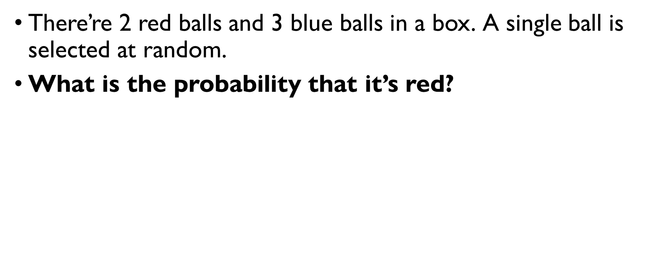
Balls in a bowl
There’re 2 red balls and 3 blue balls in a box. A single ball is selected at random.
What is the probability that it’s red?
$$P\left(R\right)=\frac{2}{2+3}=\frac{2}{5}=0.4$$

Slide 6
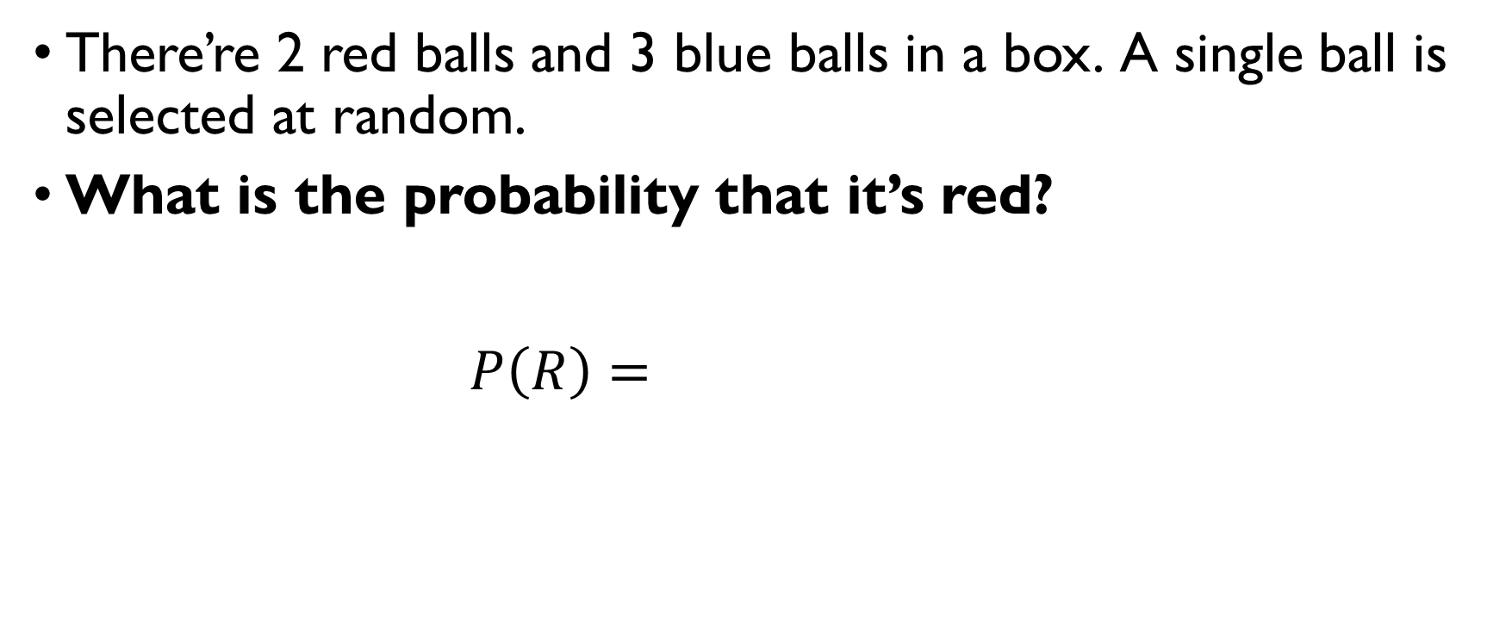
Balls in a bowl
There’re 2 red balls and 3 blue balls in a box. A single ball is selected at random.
What is the probability that it’s red?
$$P\left(R\right)=\frac{2}{2+3}=\frac{2}{5}=0.4$$

Slide 7
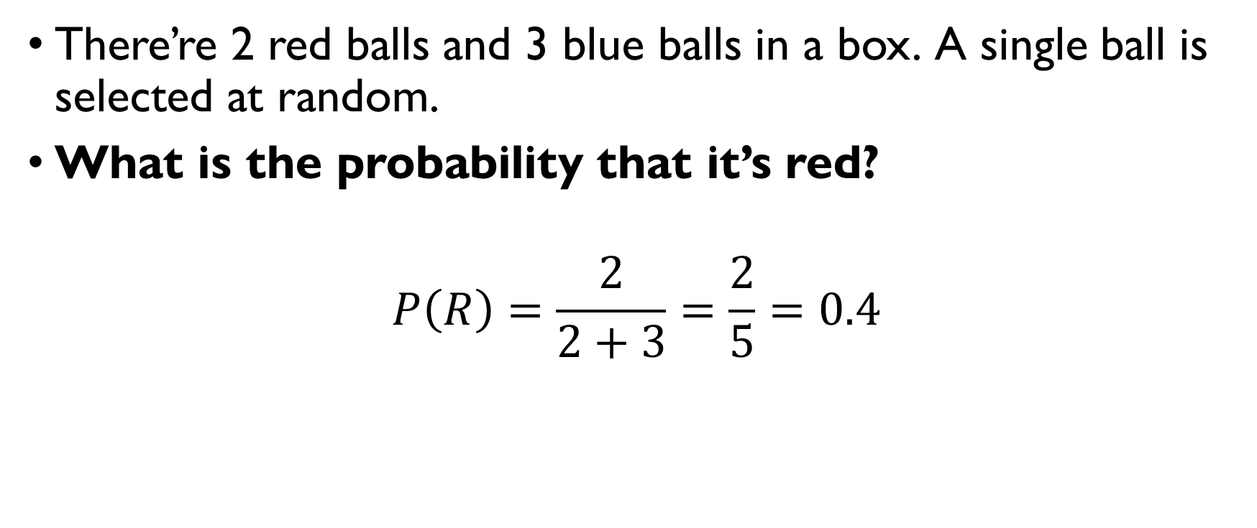
Balls in a bowl
There’re 2 red balls and 3 blue balls in a box. A single ball is selected at random.
What is the probability that it’s red?
$$P\left(R\right)=\frac{2}{2+3}=\frac{2}{5}=0.4$$

Slide 8
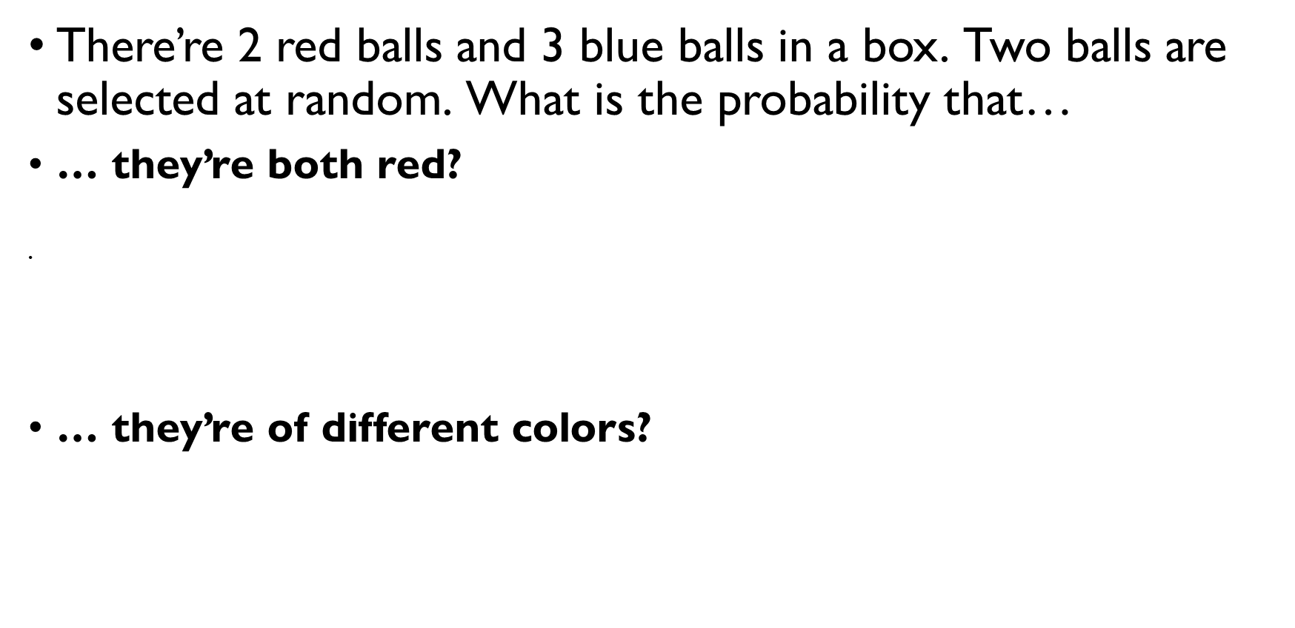
Balls in a bowl
There’re 2 red balls and 3 blue balls in a box. Two balls are selected at random. What is the probability that…
… they’re both red? You can consider it both ordered or unordered
$$P\left(RR\right)=\frac{2⋅1}{5⋅4}=\frac{C\left(2, 2\right)}{C\left(5, 2\right)}=\frac{1}{10}$$
… they’re of different colors?
$$P\left(E\right)=\frac{C\left(2,1\right)⋅2⋅3}{5⋅4}=\frac{C\left(2, 1\right)⋅C\left(3,1\right)}{C\left(5, 2\right)}=\frac{3}{5}$$

Slide 9
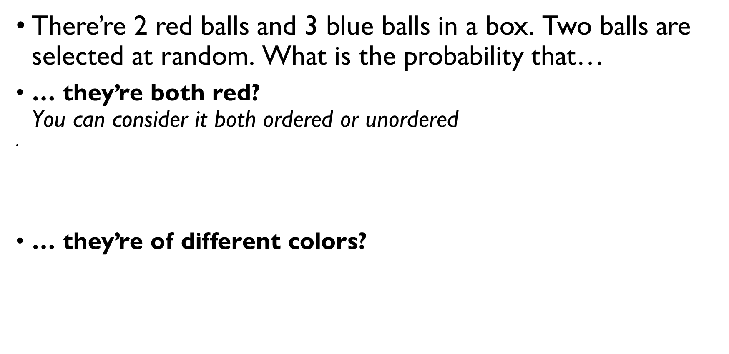
Balls in a bowl
There’re 2 red balls and 3 blue balls in a box. Two balls are selected at random. What is the probability that…
… they’re both red? You can consider it both ordered or unordered
$$P\left(RR\right)=\frac{2⋅1}{5⋅4}=\frac{C\left(2, 2\right)}{C\left(5, 2\right)}=\frac{1}{10}$$
… they’re of different colors?
$$P\left(E\right)=\frac{C\left(2,1\right)⋅2⋅3}{5⋅4}=\frac{C\left(2, 1\right)⋅C\left(3,1\right)}{C\left(5, 2\right)}=\frac{3}{5}$$

Slide 10
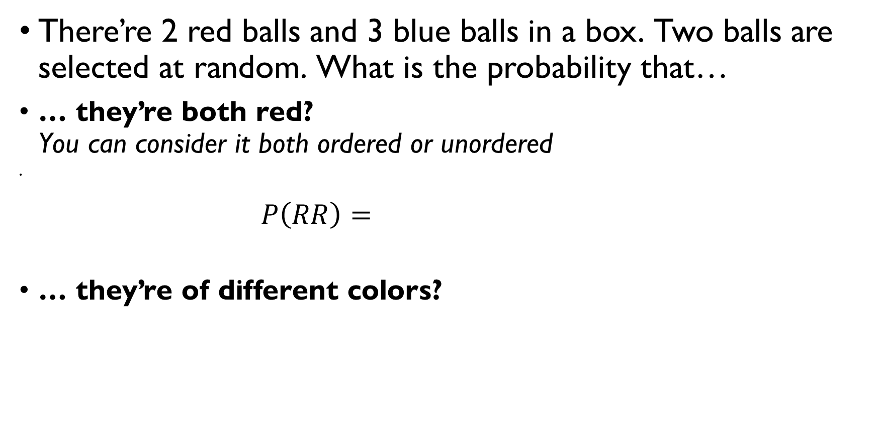
Balls in a bowl
There’re 2 red balls and 3 blue balls in a box. Two balls are selected at random. What is the probability that…
… they’re both red? You can consider it both ordered or unordered
$$P\left(RR\right)=\frac{2⋅1}{5⋅4}=\frac{C\left(2, 2\right)}{C\left(5, 2\right)}=\frac{1}{10}$$
… they’re of different colors?
$$P\left(E\right)=\frac{C\left(2,1\right)⋅2⋅3}{5⋅4}=\frac{C\left(2, 1\right)⋅C\left(3,1\right)}{C\left(5, 2\right)}=\frac{3}{5}$$

Slide 11
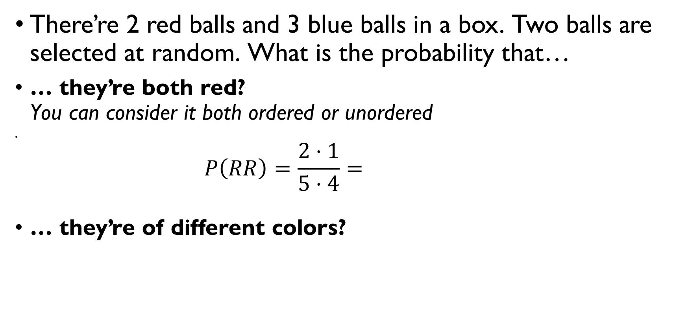
Balls in a bowl
There’re 2 red balls and 3 blue balls in a box. Two balls are selected at random. What is the probability that…
… they’re both red? You can consider it both ordered or unordered
$$P\left(RR\right)=\frac{2⋅1}{5⋅4}=\frac{C\left(2, 2\right)}{C\left(5, 2\right)}=\frac{1}{10}$$
… they’re of different colors?
$$P\left(E\right)=\frac{C\left(2,1\right)⋅2⋅3}{5⋅4}=\frac{C\left(2, 1\right)⋅C\left(3,1\right)}{C\left(5, 2\right)}=\frac{3}{5}$$

Slide 12
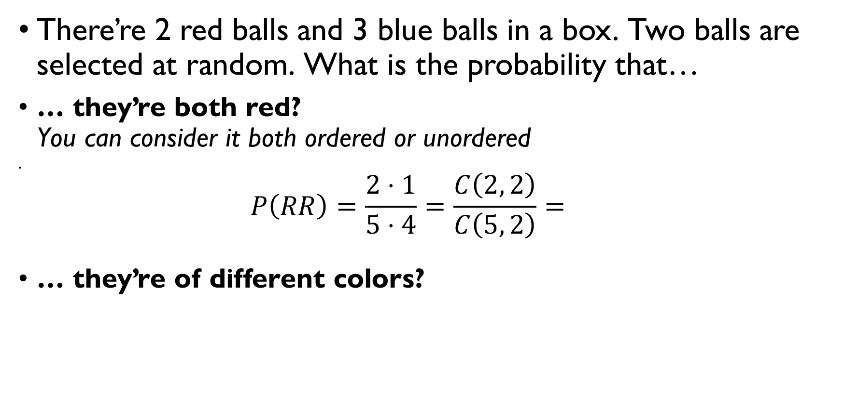
Balls in a bowl
There’re 2 red balls and 3 blue balls in a box. Two balls are selected at random. What is the probability that…
… they’re both red? You can consider it both ordered or unordered
$$P\left(RR\right)=\frac{2⋅1}{5⋅4}=\frac{C\left(2, 2\right)}{C\left(5, 2\right)}=\frac{1}{10}$$
… they’re of different colors?
$$P\left(E\right)=\frac{C\left(2,1\right)⋅2⋅3}{5⋅4}=\frac{C\left(2, 1\right)⋅C\left(3,1\right)}{C\left(5, 2\right)}=\frac{3}{5}$$

Slide 13
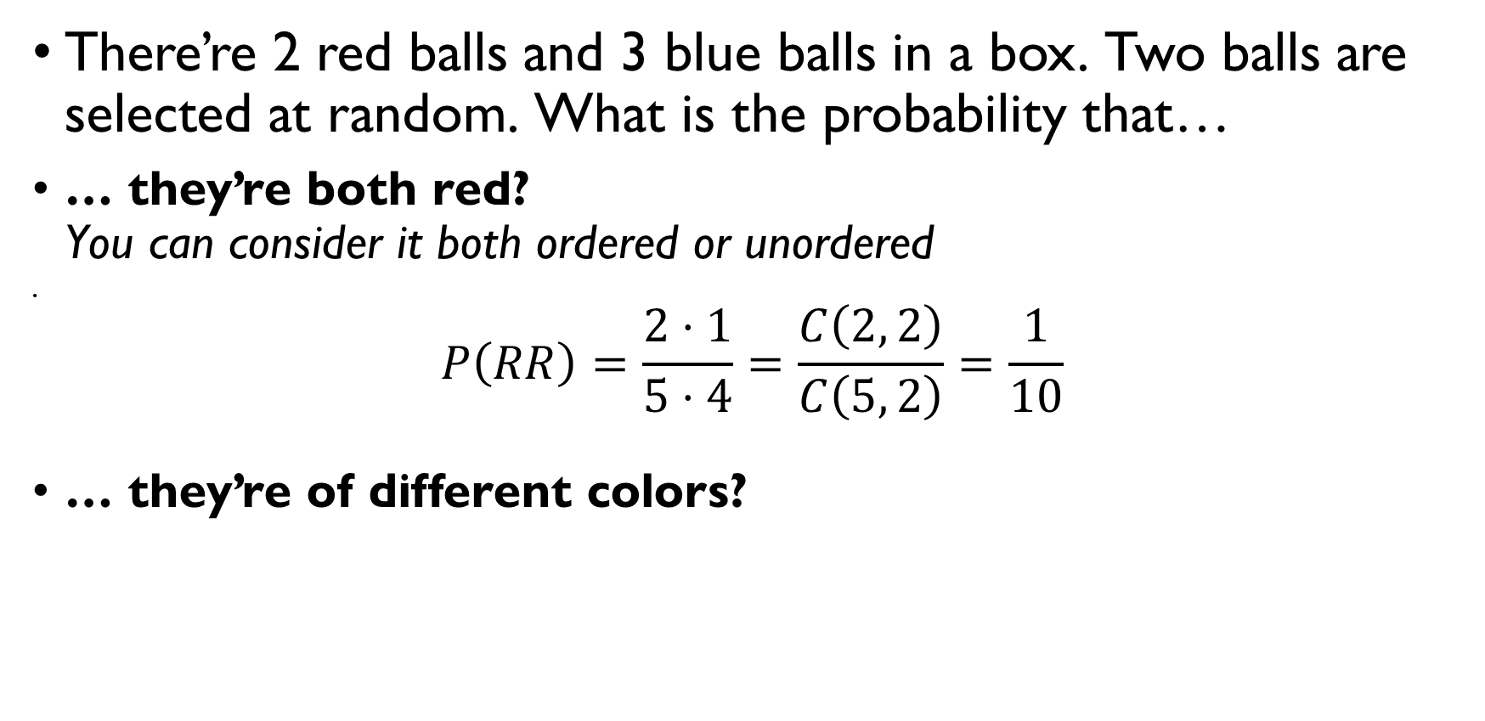
Balls in a bowl
There’re 2 red balls and 3 blue balls in a box. Two balls are selected at random. What is the probability that…
… they’re both red? You can consider it both ordered or unordered
$$P\left(RR\right)=\frac{2⋅1}{5⋅4}=\frac{C\left(2, 2\right)}{C\left(5, 2\right)}=\frac{1}{10}$$
… they’re of different colors?
$$P\left(E\right)=\frac{C\left(2,1\right)⋅2⋅3}{5⋅4}=\frac{C\left(2, 1\right)⋅C\left(3,1\right)}{C\left(5, 2\right)}=\frac{3}{5}$$

Slide 14
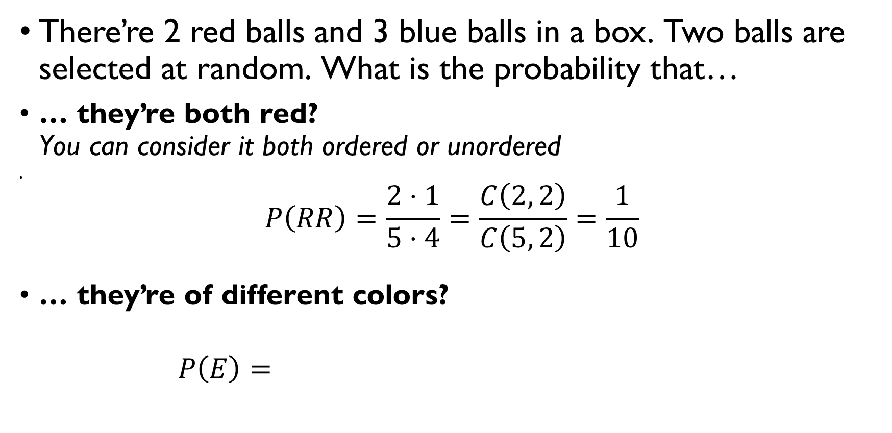
Balls in a bowl
There’re 2 red balls and 3 blue balls in a box. Two balls are selected at random. What is the probability that…
… they’re both red? You can consider it both ordered or unordered
$$P\left(RR\right)=\frac{2⋅1}{5⋅4}=\frac{C\left(2, 2\right)}{C\left(5, 2\right)}=\frac{1}{10}$$
… they’re of different colors?
$$P\left(E\right)=\frac{C\left(2,1\right)⋅2⋅3}{5⋅4}=\frac{C\left(2, 1\right)⋅C\left(3,1\right)}{C\left(5, 2\right)}=\frac{3}{5}$$

Slide 15
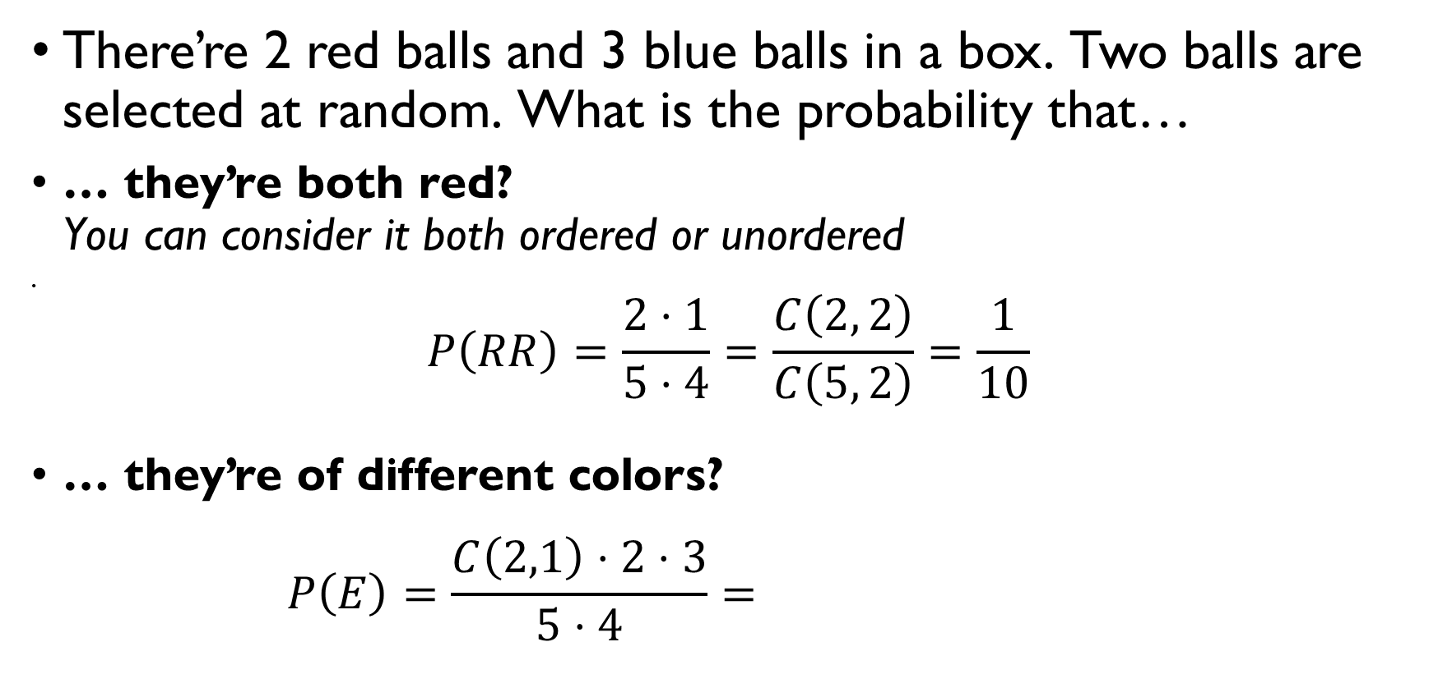
Balls in a bowl
There’re 2 red balls and 3 blue balls in a box. Two balls are selected at random. What is the probability that…
… they’re both red? You can consider it both ordered or unordered
$$P\left(RR\right)=\frac{2⋅1}{5⋅4}=\frac{C\left(2, 2\right)}{C\left(5, 2\right)}=\frac{1}{10}$$
… they’re of different colors?
$$P\left(E\right)=\frac{C\left(2,1\right)⋅2⋅3}{5⋅4}=\frac{C\left(2, 1\right)⋅C\left(3,1\right)}{C\left(5, 2\right)}=\frac{3}{5}$$

Slide 16
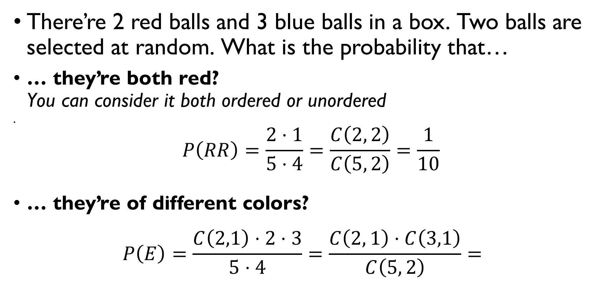
Balls in a bowl
There’re 2 red balls and 3 blue balls in a box. Two balls are selected at random. What is the probability that…
… they’re both red? You can consider it both ordered or unordered
$$P\left(RR\right)=\frac{2⋅1}{5⋅4}=\frac{C\left(2, 2\right)}{C\left(5, 2\right)}=\frac{1}{10}$$
… they’re of different colors?
$$P\left(E\right)=\frac{C\left(2,1\right)⋅2⋅3}{5⋅4}=\frac{C\left(2, 1\right)⋅C\left(3,1\right)}{C\left(5, 2\right)}=\frac{3}{5}$$

Slide 17
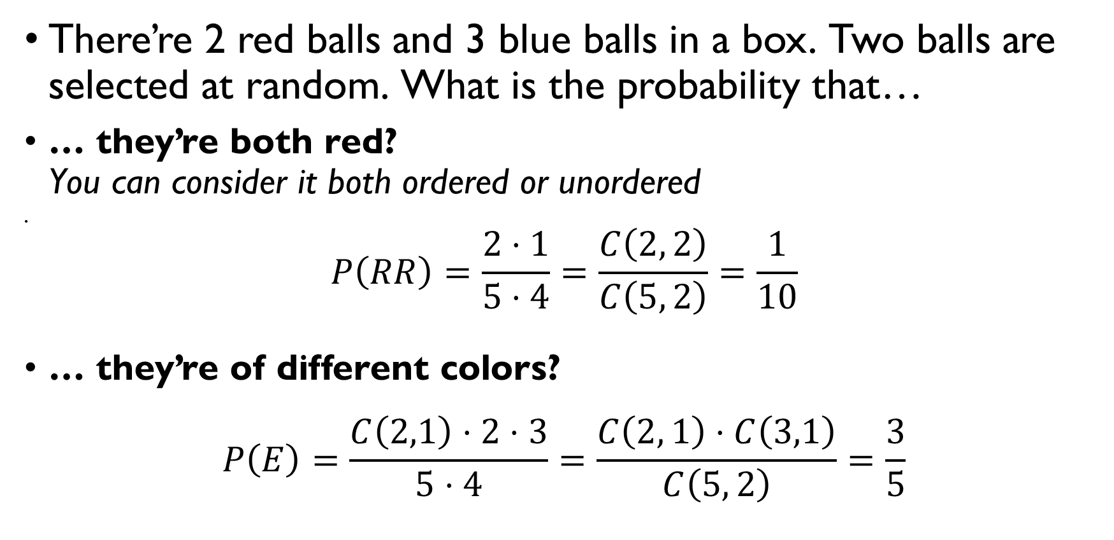
Balls in a bowl
There’re 2 red balls and 3 blue balls in a box. Two balls are selected at random. What is the probability that…
… they’re both red? You can consider it both ordered or unordered
$$P\left(RR\right)=\frac{2⋅1}{5⋅4}=\frac{C\left(2, 2\right)}{C\left(5, 2\right)}=\frac{1}{10}$$
… they’re of different colors?
$$P\left(E\right)=\frac{C\left(2,1\right)⋅2⋅3}{5⋅4}=\frac{C\left(2, 1\right)⋅C\left(3,1\right)}{C\left(5, 2\right)}=\frac{3}{5}$$

Slide 18
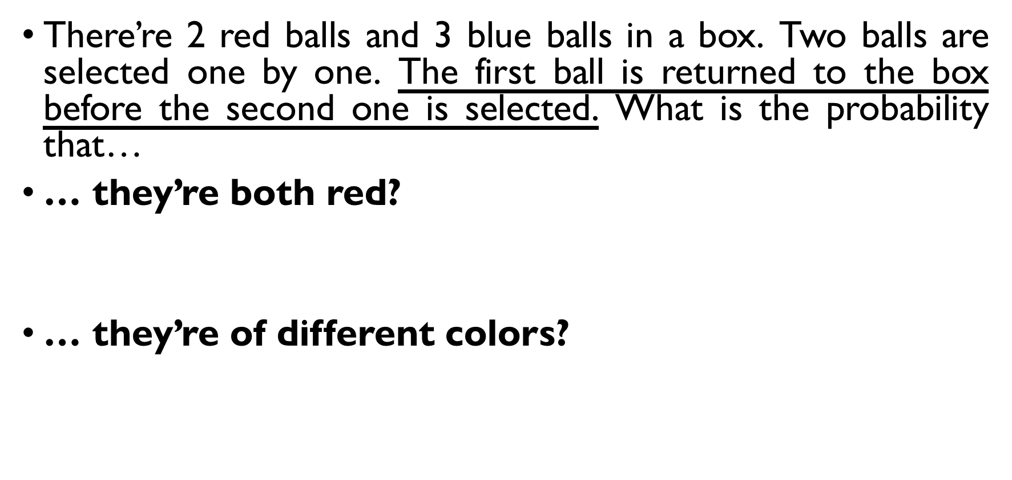
Balls in a bowl
There’re 2 red balls and 3 blue balls in a box. Two balls are selected one by one. The first ball is returned to the box before the second one is selected. What is the probability that…
… they’re both red?
$$P\left(RR\right)=\frac{2⋅2}{5⋅5}=\frac{4}{25}$$
… they’re of different colors?
$$P\left(E\right)=\frac{C\left(2,1\right)⋅2⋅3}{5⋅5}=\frac{12}{25}$$

Slide 19
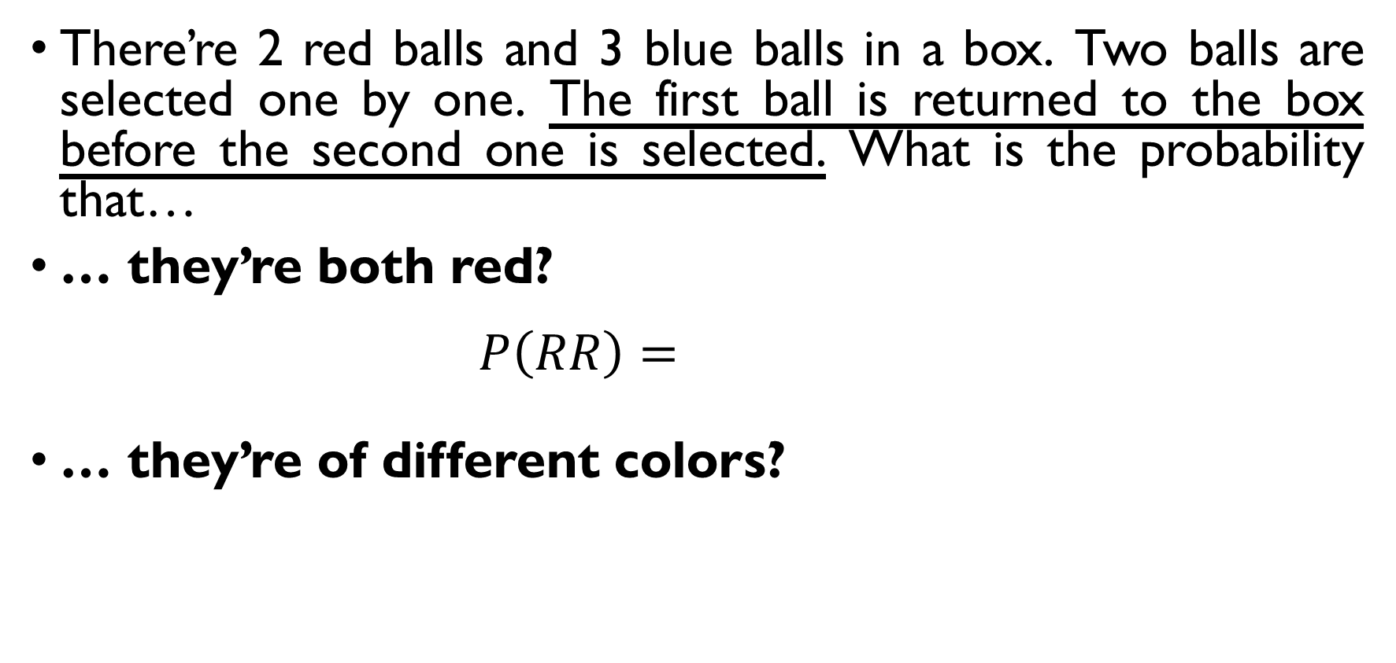
Balls in a bowl
There’re 2 red balls and 3 blue balls in a box. Two balls are selected one by one. The first ball is returned to the box before the second one is selected. What is the probability that…
… they’re both red?
$$P\left(RR\right)=\frac{2⋅2}{5⋅5}=\frac{4}{25}$$
… they’re of different colors?
$$P\left(E\right)=\frac{C\left(2,1\right)⋅2⋅3}{5⋅5}=\frac{12}{25}$$

Slide 20
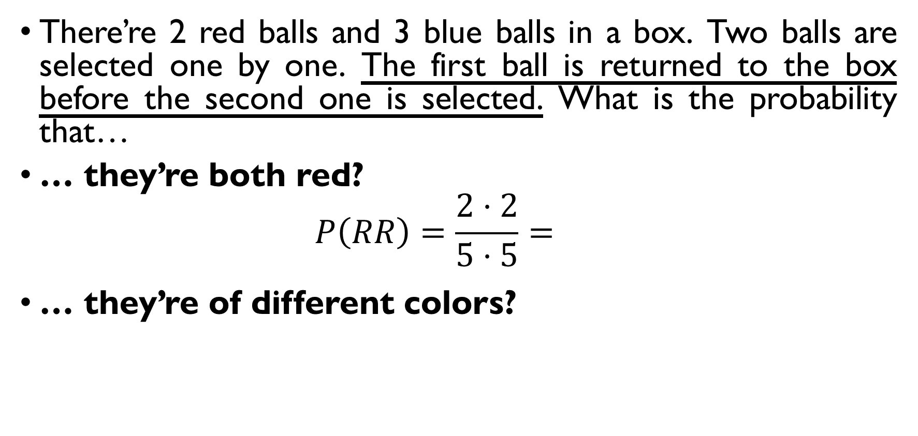
Balls in a bowl
There’re 2 red balls and 3 blue balls in a box. Two balls are selected one by one. The first ball is returned to the box before the second one is selected. What is the probability that…
… they’re both red?
$$P\left(RR\right)=\frac{2⋅2}{5⋅5}=\frac{4}{25}$$
… they’re of different colors?
$$P\left(E\right)=\frac{C\left(2,1\right)⋅2⋅3}{5⋅5}=\frac{12}{25}$$

Slide 21
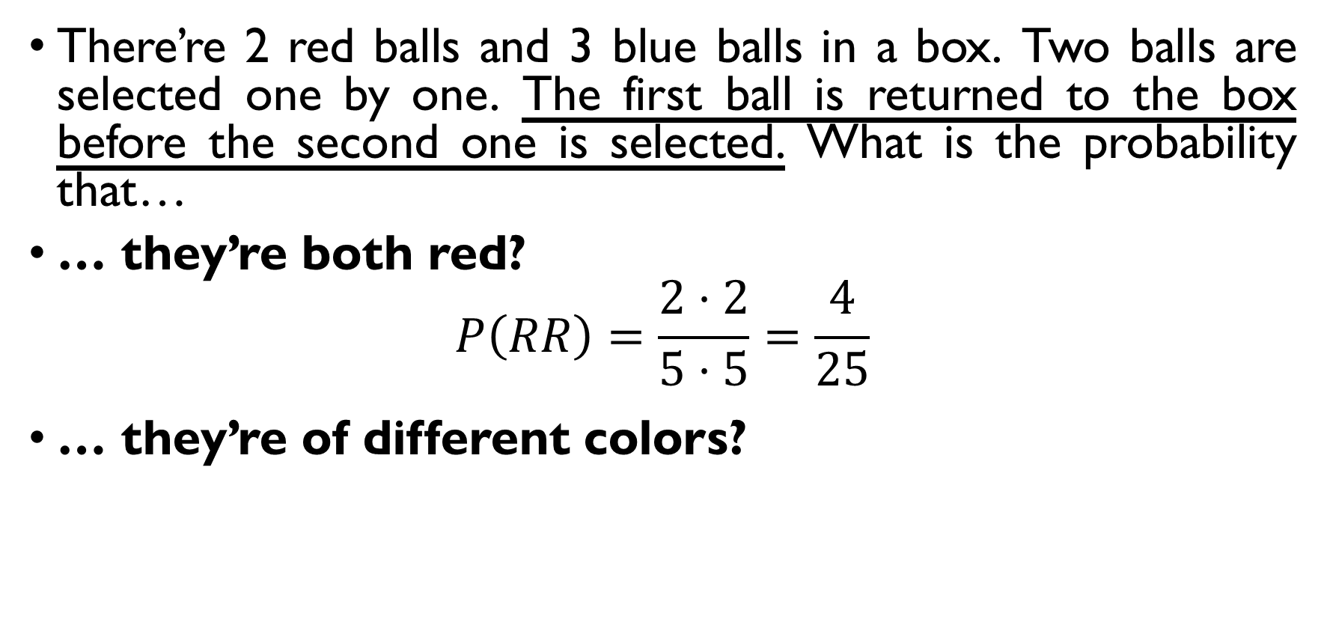
Balls in a bowl
There’re 2 red balls and 3 blue balls in a box. Two balls are selected one by one. The first ball is returned to the box before the second one is selected. What is the probability that…
… they’re both red?
$$P\left(RR\right)=\frac{2⋅2}{5⋅5}=\frac{4}{25}$$
… they’re of different colors?
$$P\left(E\right)=\frac{C\left(2,1\right)⋅2⋅3}{5⋅5}=\frac{12}{25}$$

Slide 22
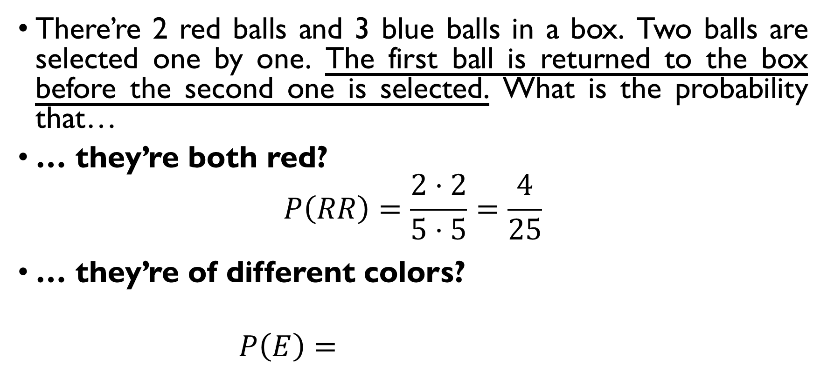
Balls in a bowl
There’re 2 red balls and 3 blue balls in a box. Two balls are selected one by one. The first ball is returned to the box before the second one is selected. What is the probability that…
… they’re both red?
$$P\left(RR\right)=\frac{2⋅2}{5⋅5}=\frac{4}{25}$$
… they’re of different colors?
$$P\left(E\right)=\frac{C\left(2,1\right)⋅2⋅3}{5⋅5}=\frac{12}{25}$$

Slide 23
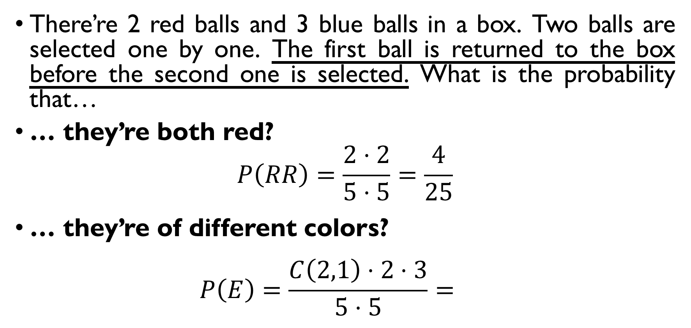
Balls in a bowl
There’re 2 red balls and 3 blue balls in a box. Two balls are selected one by one. The first ball is returned to the box before the second one is selected. What is the probability that…
… they’re both red?
$$P\left(RR\right)=\frac{2⋅2}{5⋅5}=\frac{4}{25}$$
… they’re of different colors?
$$P\left(E\right)=\frac{C\left(2,1\right)⋅2⋅3}{5⋅5}=\frac{12}{25}$$

Slide 24
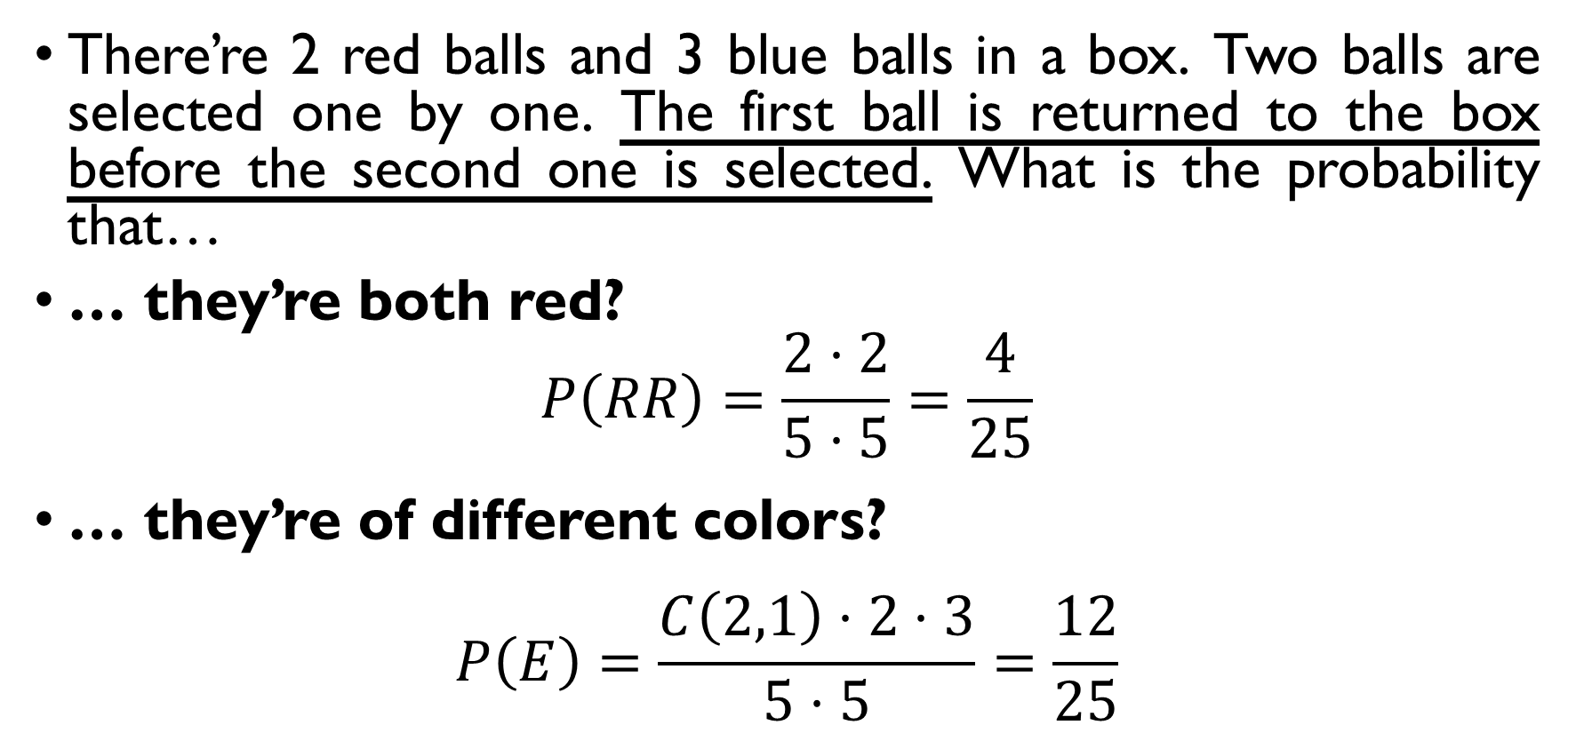
Balls in a bowl
There’re 2 red balls and 3 blue balls in a box. Two balls are selected one by one. The first ball is returned to the box before the second one is selected. What is the probability that…
… they’re both red?
$$P\left(RR\right)=\frac{2⋅2}{5⋅5}=\frac{4}{25}$$
… they’re of different colors?
$$P\left(E\right)=\frac{C\left(2,1\right)⋅2⋅3}{5⋅5}=\frac{12}{25}$$

Slide 25
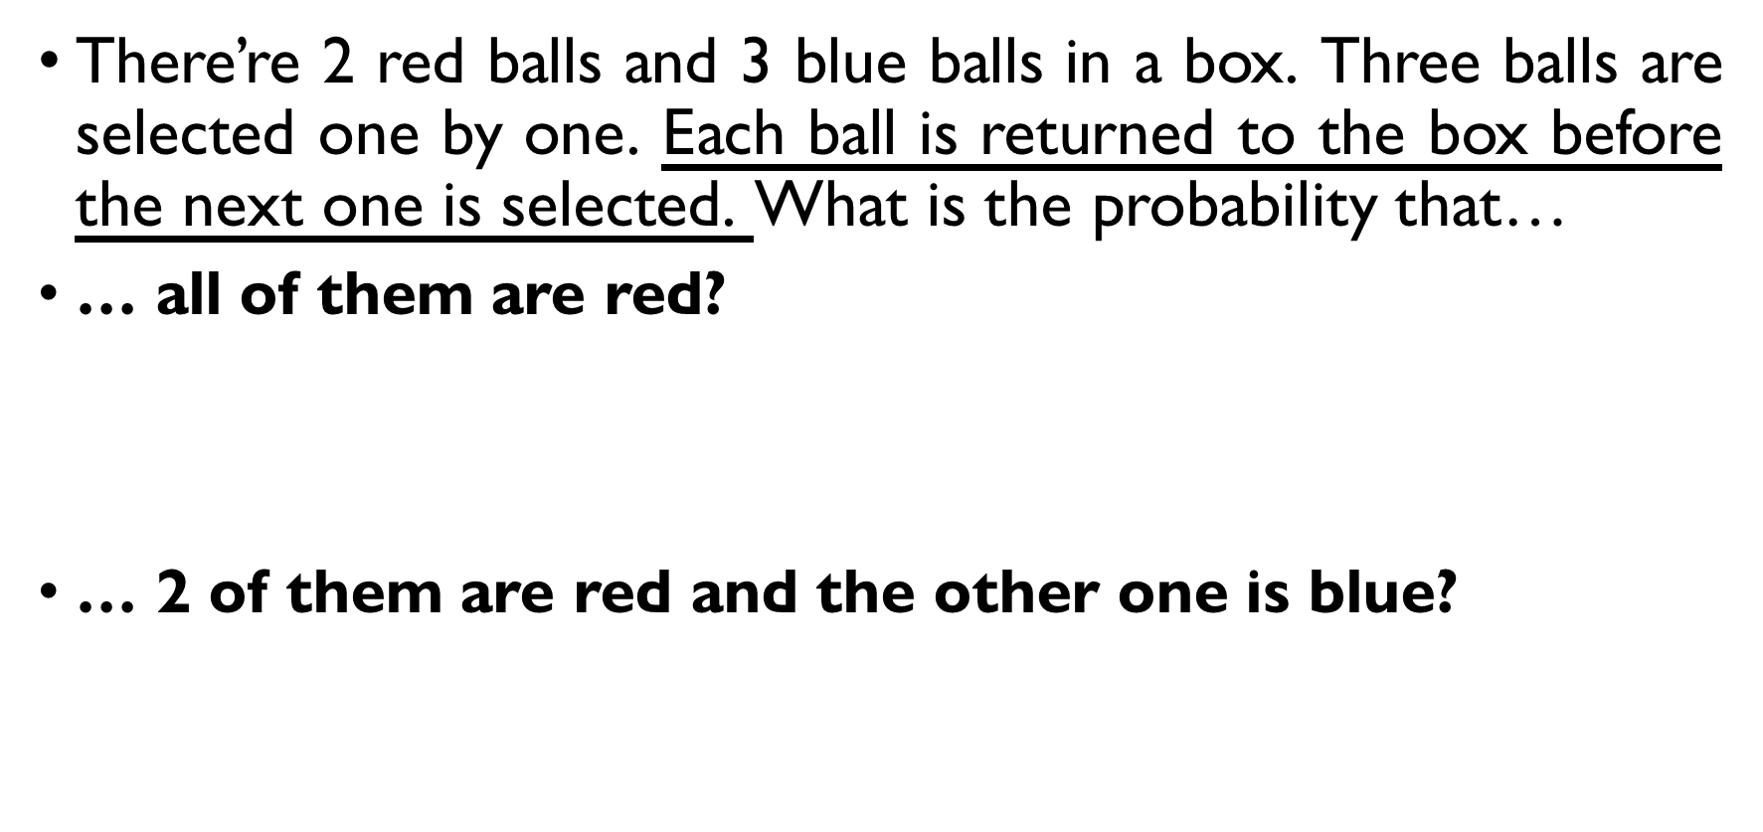
Balls in a bowl
There’re 2 red balls and 3 blue balls in a box. Three balls are selected one by one. Each ball is returned to the box before the next one is selected. What is the probability that…
… all of them are red?
$$P\left(RRR\right)=\frac{2⋅2⋅2}{5^{3}}=\frac{8}{125}$$
… 2 of them are red and the other one is blue?
$$P\left(E\right)=\frac{C\left(3,1\right)⋅{3⋅2}^{2}}{5^{3}}=\frac{36}{125}$$

Slide 26
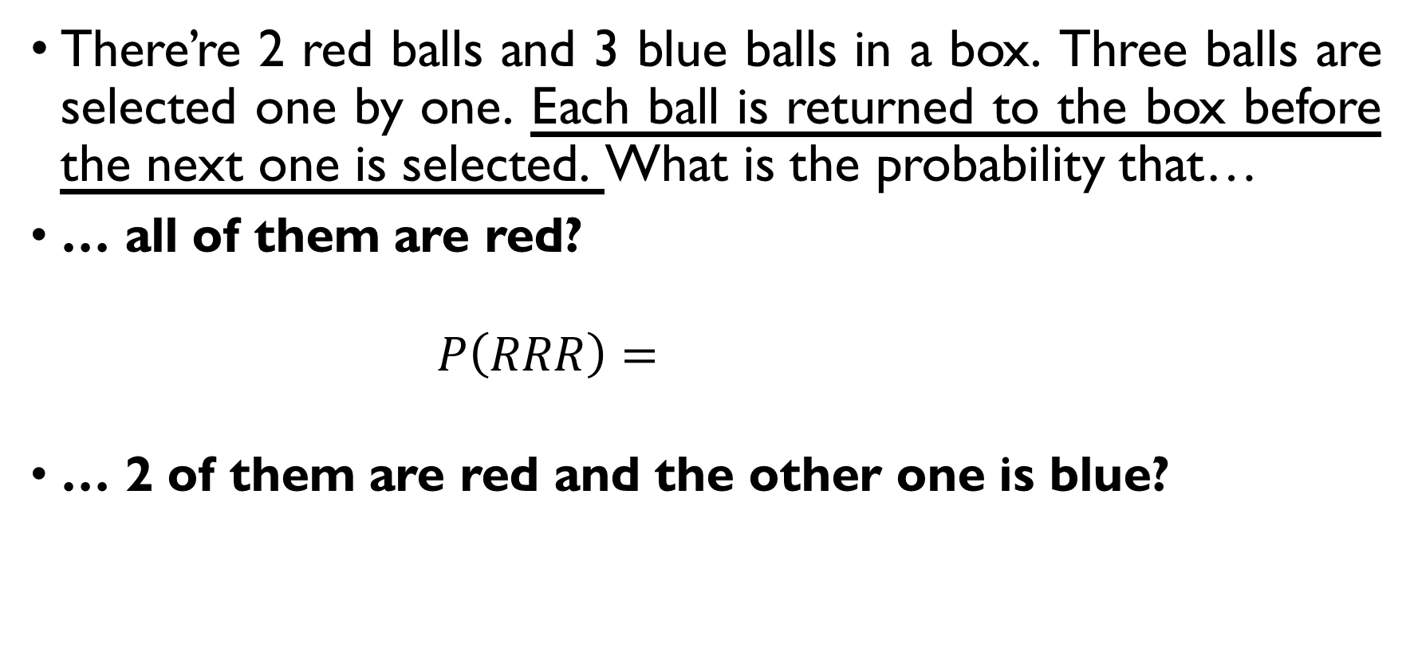
Balls in a bowl
There’re 2 red balls and 3 blue balls in a box. Three balls are selected one by one. Each ball is returned to the box before the next one is selected. What is the probability that…
… all of them are red?
$$P\left(RRR\right)=\frac{2⋅2⋅2}{5^{3}}=\frac{8}{125}$$
… 2 of them are red and the other one is blue?
$$P\left(E\right)=\frac{C\left(3,1\right)⋅{3⋅2}^{2}}{5^{3}}=\frac{36}{125}$$

Slide 27
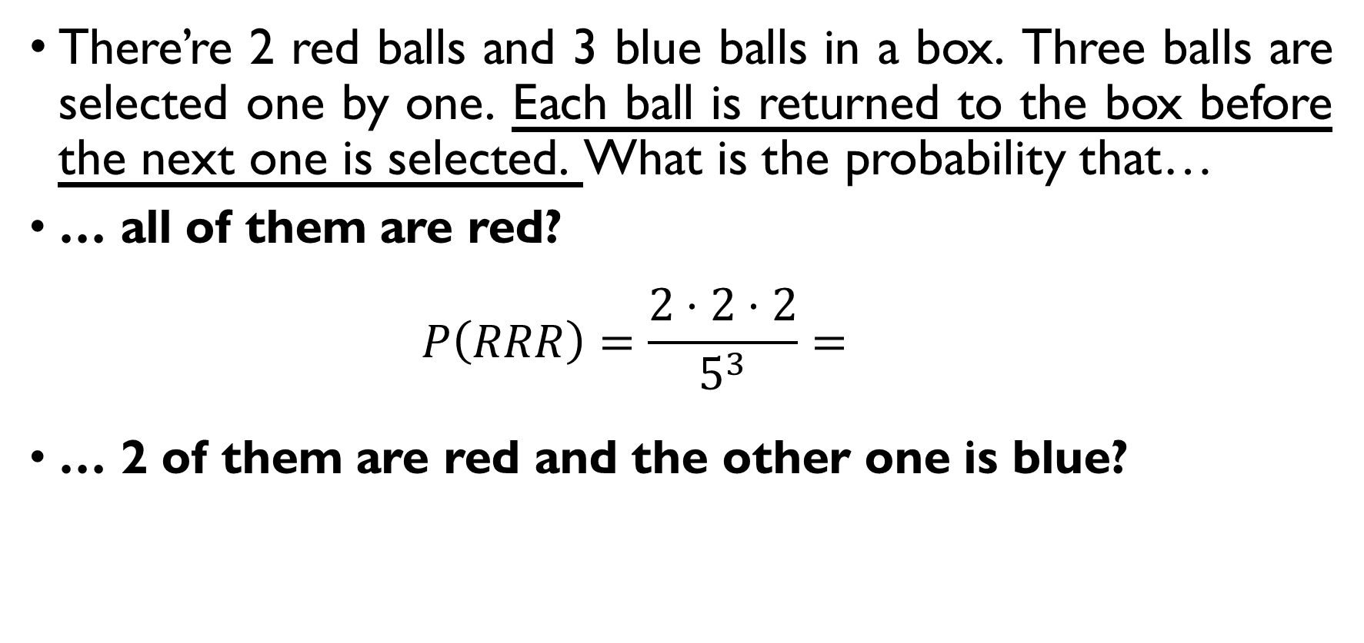
Balls in a bowl
There’re 2 red balls and 3 blue balls in a box. Three balls are selected one by one. Each ball is returned to the box before the next one is selected. What is the probability that…
… all of them are red?
$$P\left(RRR\right)=\frac{2⋅2⋅2}{5^{3}}=\frac{8}{125}$$
… 2 of them are red and the other one is blue?
$$P\left(E\right)=\frac{C\left(3,1\right)⋅{3⋅2}^{2}}{5^{3}}=\frac{36}{125}$$

Slide 28
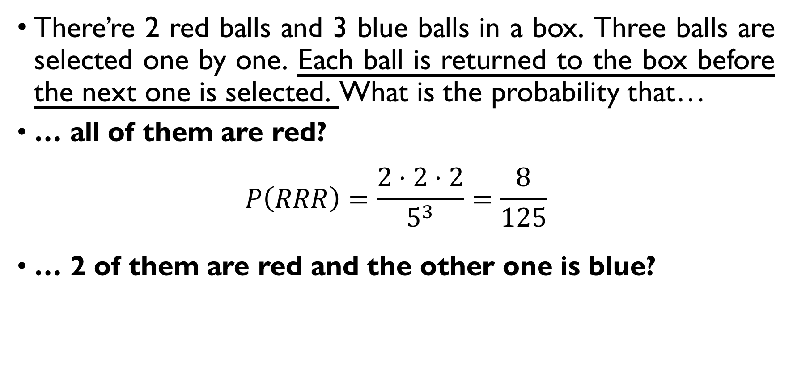
Balls in a bowl
There’re 2 red balls and 3 blue balls in a box. Three balls are selected one by one. Each ball is returned to the box before the next one is selected. What is the probability that…
… all of them are red?
$$P\left(RRR\right)=\frac{2⋅2⋅2}{5^{3}}=\frac{8}{125}$$
… 2 of them are red and the other one is blue?
$$P\left(E\right)=\frac{C\left(3,1\right)⋅{3⋅2}^{2}}{5^{3}}=\frac{36}{125}$$

Slide 29
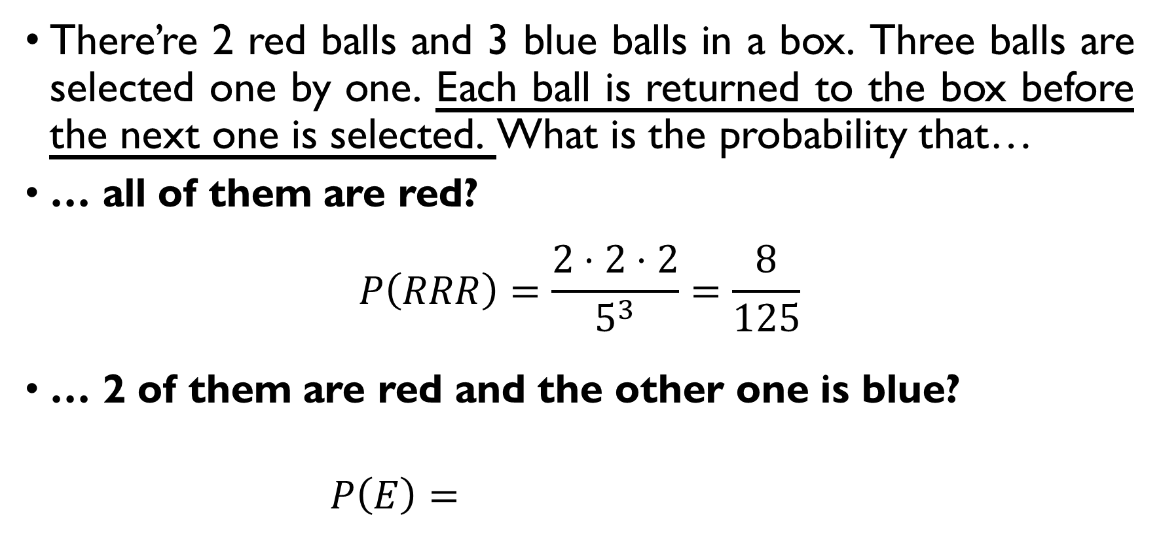
Balls in a bowl
There’re 2 red balls and 3 blue balls in a box. Three balls are selected one by one. Each ball is returned to the box before the next one is selected. What is the probability that…
… all of them are red?
$$P\left(RRR\right)=\frac{2⋅2⋅2}{5^{3}}=\frac{8}{125}$$
… 2 of them are red and the other one is blue?
$$P\left(E\right)=\frac{C\left(3,1\right)⋅{3⋅2}^{2}}{5^{3}}=\frac{36}{125}$$

Slide 30
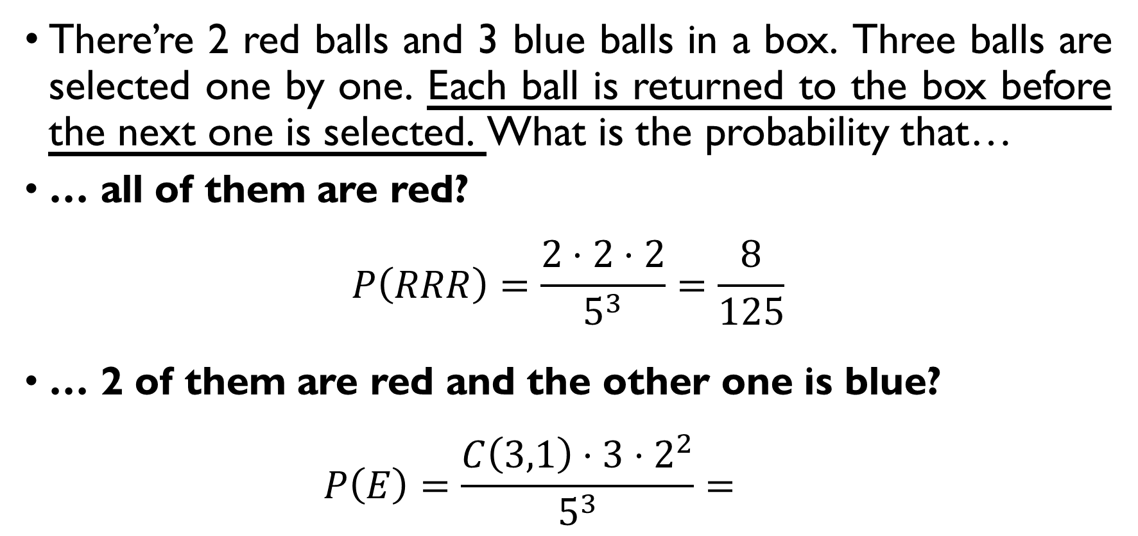
Balls in a bowl
There’re 2 red balls and 3 blue balls in a box. Three balls are selected one by one. Each ball is returned to the box before the next one is selected. What is the probability that…
… all of them are red?
$$P\left(RRR\right)=\frac{2⋅2⋅2}{5^{3}}=\frac{8}{125}$$
… 2 of them are red and the other one is blue?
$$P\left(E\right)=\frac{C\left(3,1\right)⋅{3⋅2}^{2}}{5^{3}}=\frac{36}{125}$$

Slide 31
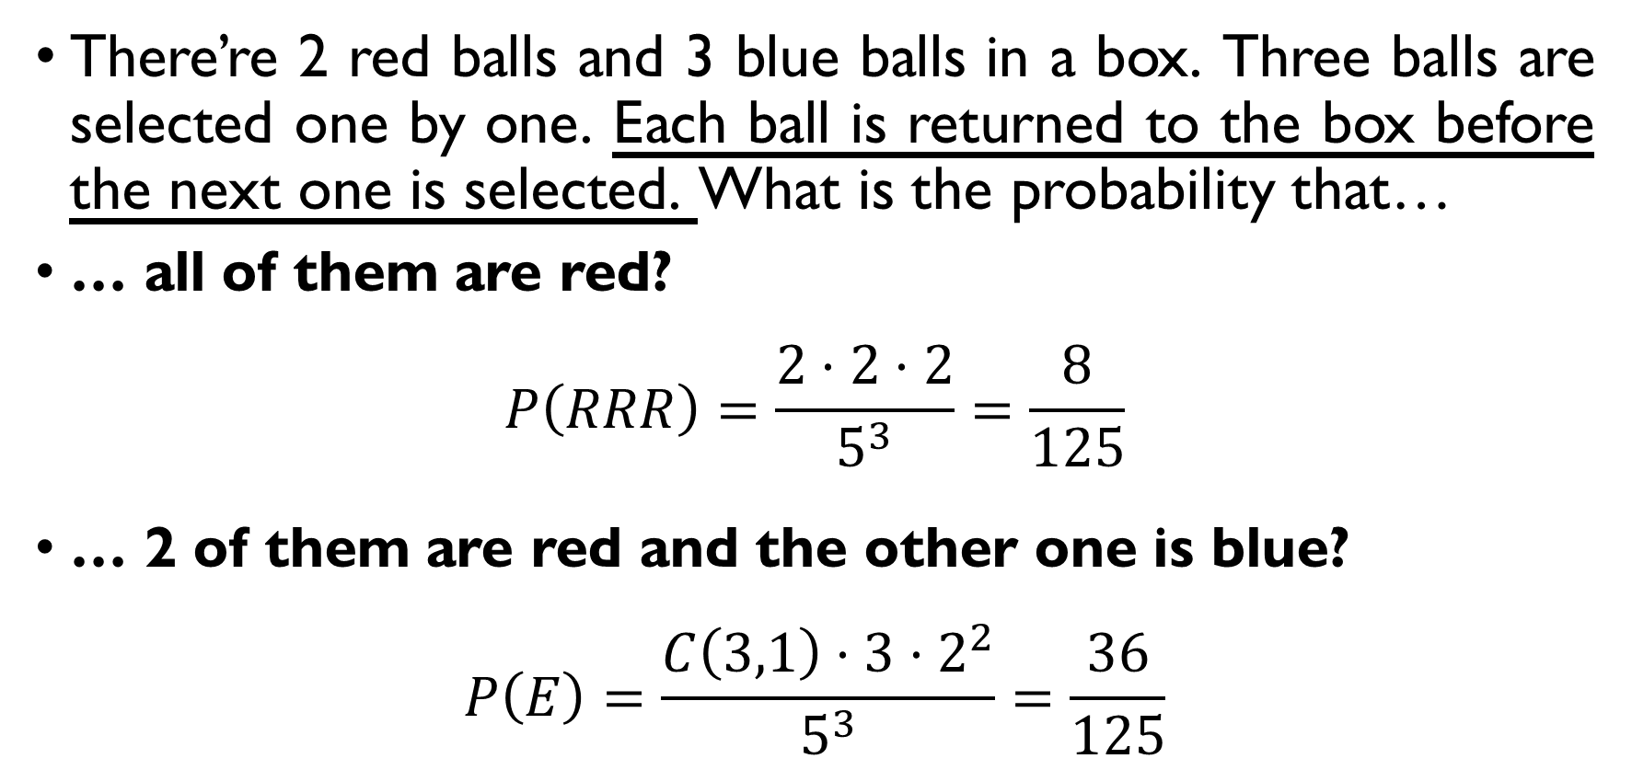
Balls in a bowl
There’re 2 red balls and 3 blue balls in a box. Three balls are selected one by one. Each ball is returned to the box before the next one is selected. What is the probability that…
… all of them are red?
$$P\left(RRR\right)=\frac{2⋅2⋅2}{5^{3}}=\frac{8}{125}$$
… 2 of them are red and the other one is blue?
$$P\left(E\right)=\frac{C\left(3,1\right)⋅{3⋅2}^{2}}{5^{3}}=\frac{36}{125}$$

Slide 32
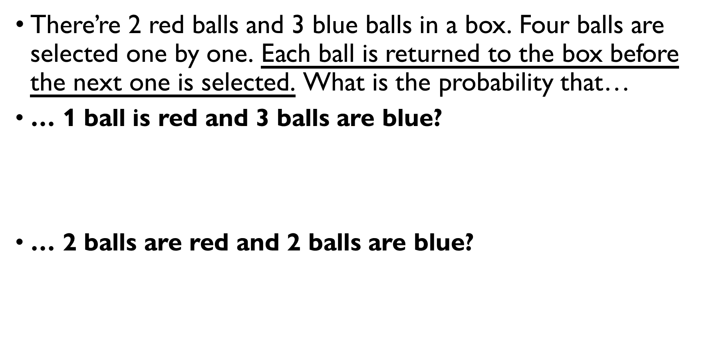
Balls in a bowl
There’re 2 red balls and 3 blue balls in a box. Four balls are selected one by one. Each ball is returned to the box before the next one is selected. What is the probability that…
… 1 ball is red and 3 balls are blue?
$$P\left(E\right)=\frac{C\left(4,1\right)⋅2⋅3^{3}}{5^{4}}$$
… 2 balls are red and 2 balls are blue?
$$P\left(E\right)=\frac{C\left(4,2\right)⋅2^{2}⋅3^{2}}{5^{4}}$$

Slide 33
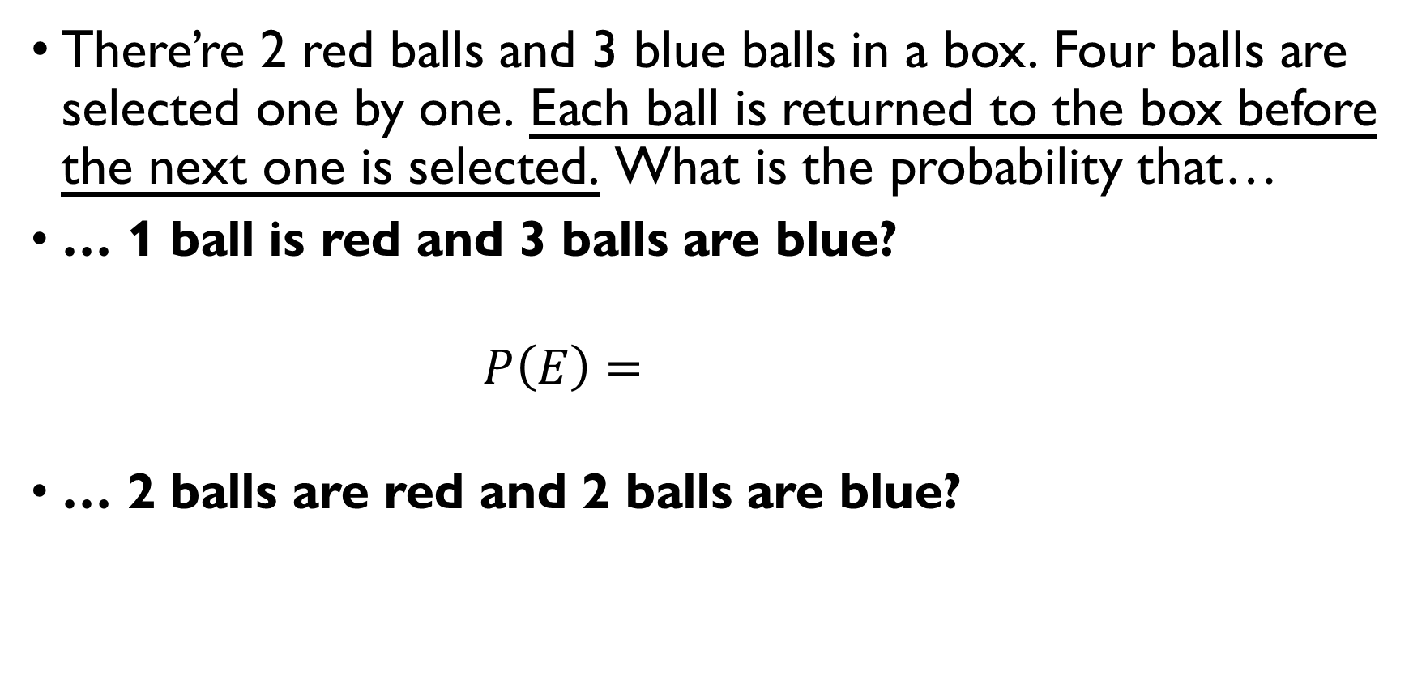
Balls in a bowl
There’re 2 red balls and 3 blue balls in a box. Four balls are selected one by one. Each ball is returned to the box before the next one is selected. What is the probability that…
… 1 ball is red and 3 balls are blue?
$$P\left(E\right)=\frac{C\left(4,1\right)⋅2⋅3^{3}}{5^{4}}$$
… 2 balls are red and 2 balls are blue?
$$P\left(E\right)=\frac{C\left(4,2\right)⋅2^{2}⋅3^{2}}{5^{4}}$$

Slide 34
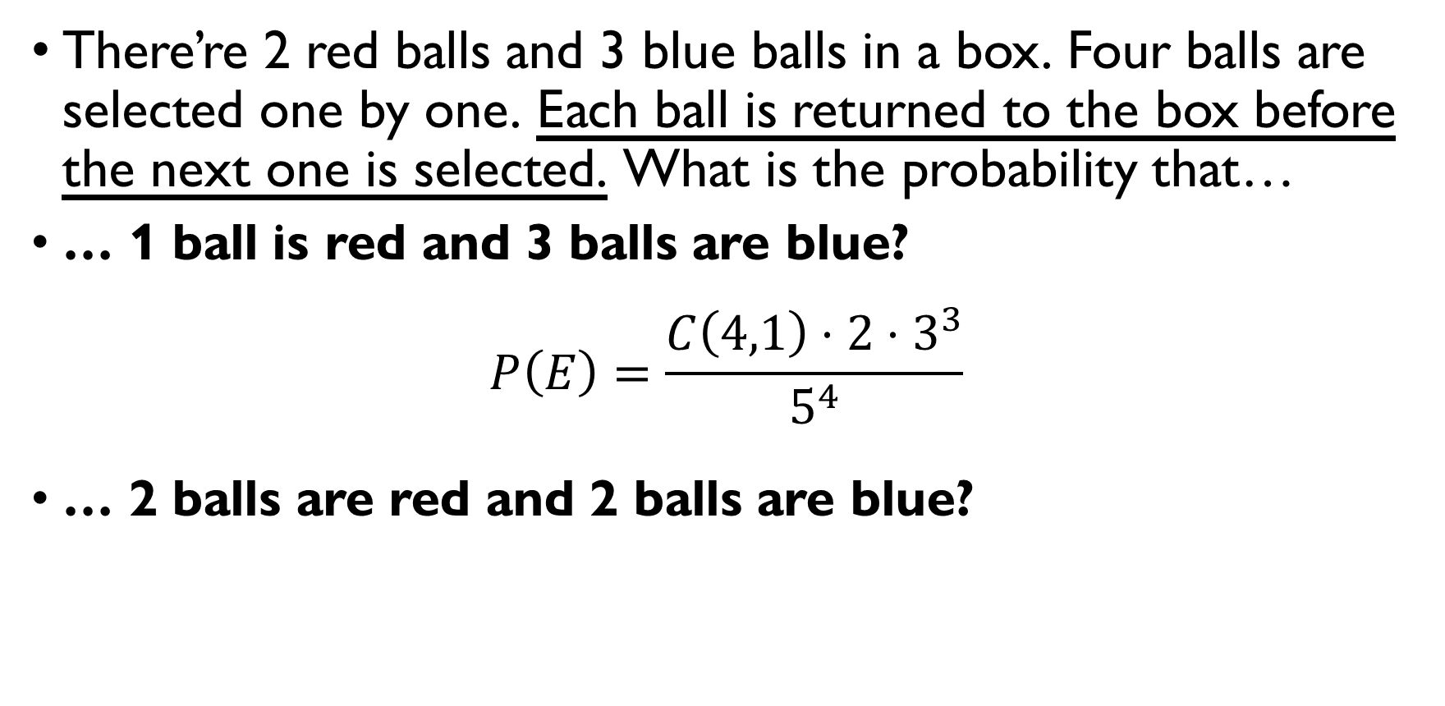
Balls in a bowl
There’re 2 red balls and 3 blue balls in a box. Four balls are selected one by one. Each ball is returned to the box before the next one is selected. What is the probability that…
… 1 ball is red and 3 balls are blue?
$$P\left(E\right)=\frac{C\left(4,1\right)⋅2⋅3^{3}}{5^{4}}$$
… 2 balls are red and 2 balls are blue?
$$P\left(E\right)=\frac{C\left(4,2\right)⋅2^{2}⋅3^{2}}{5^{4}}$$

Slide 35
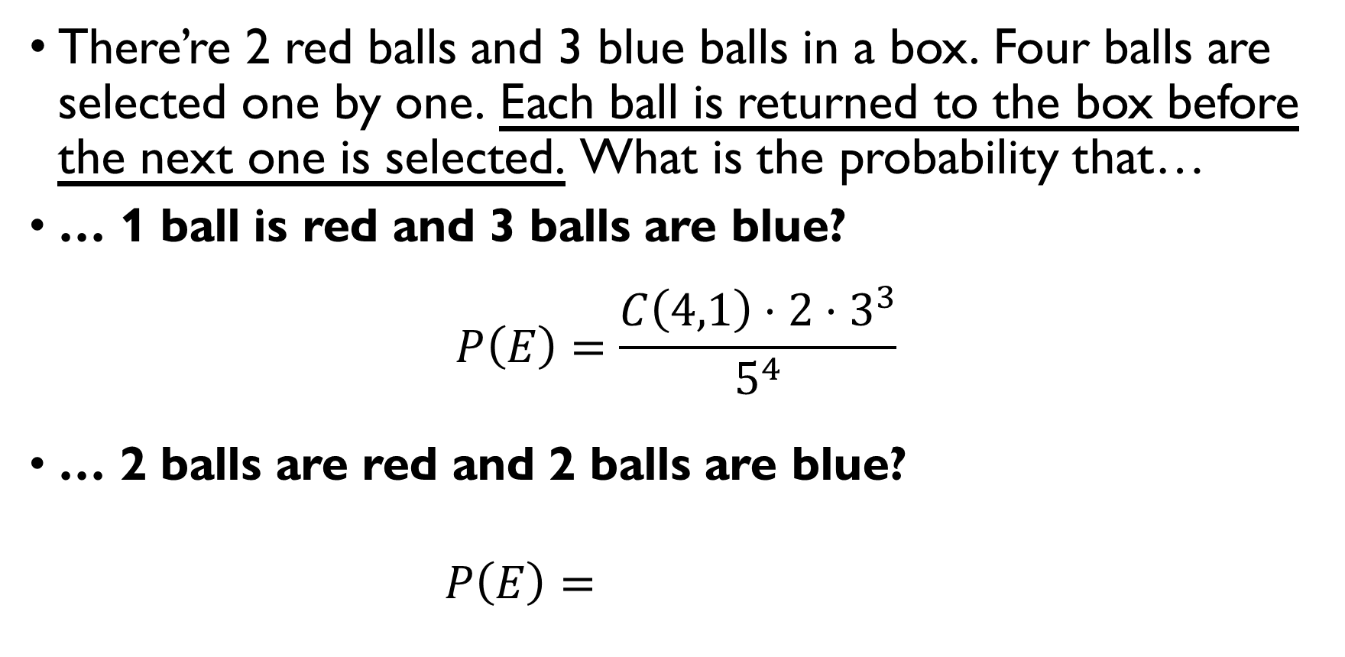
Balls in a bowl
There’re 2 red balls and 3 blue balls in a box. Four balls are selected one by one. Each ball is returned to the box before the next one is selected. What is the probability that…
… 1 ball is red and 3 balls are blue?
$$P\left(E\right)=\frac{C\left(4,1\right)⋅2⋅3^{3}}{5^{4}}$$
… 2 balls are red and 2 balls are blue?
$$P\left(E\right)=\frac{C\left(4,2\right)⋅2^{2}⋅3^{2}}{5^{4}}$$

Slide 36
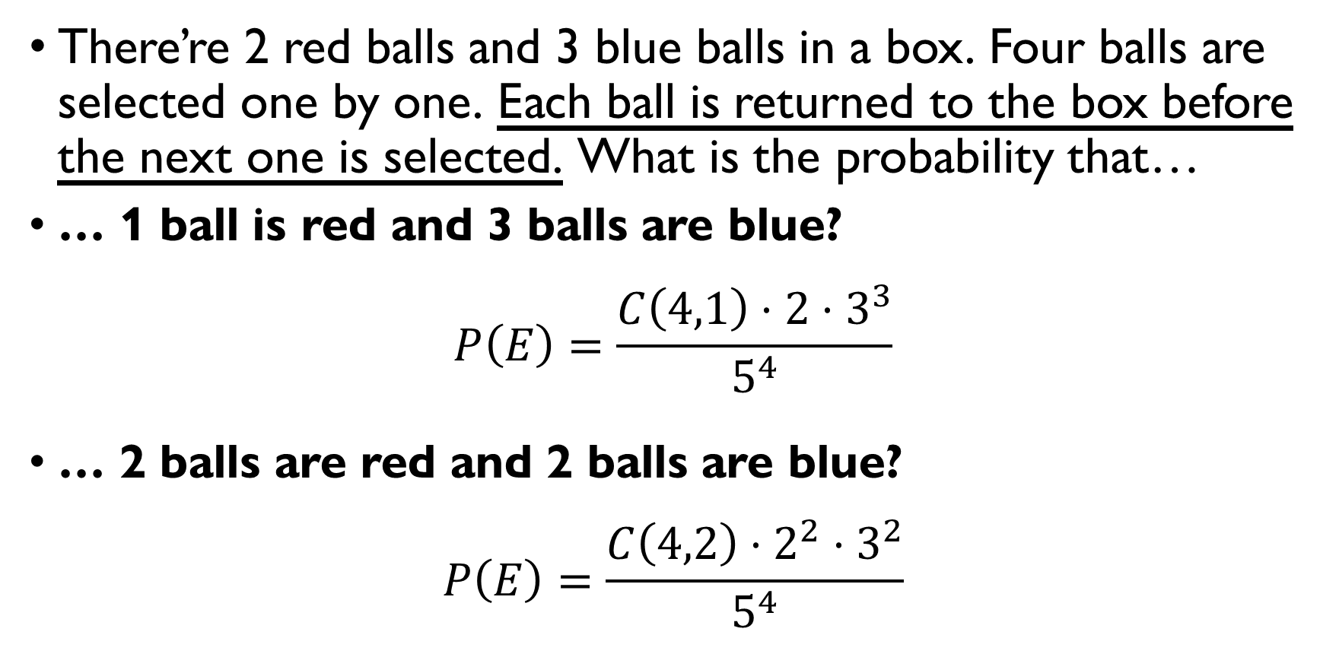
Balls in a bowl
There’re 2 red balls and 3 blue balls in a box. Four balls are selected one by one. Each ball is returned to the box before the next one is selected. What is the probability that…
… 1 ball is red and 3 balls are blue?
$$P\left(E\right)=\frac{C\left(4,1\right)⋅2⋅3^{3}}{5^{4}}$$
… 2 balls are red and 2 balls are blue?
$$P\left(E\right)=\frac{C\left(4,2\right)⋅2^{2}⋅3^{2}}{5^{4}}$$

Slide 37
Problem set 7
Conditional probability, the law of total probability

Slide 38
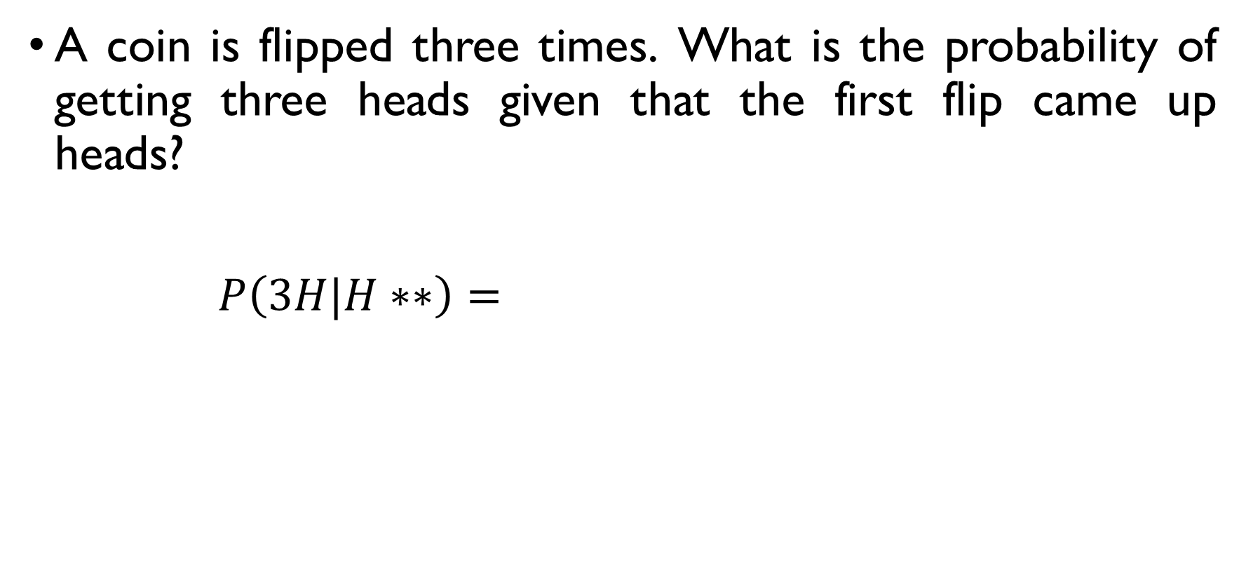
coins
A coin is flipped three times. What is the probability of getting three heads given that the first flip came up heads?
$$P\left(3H|H∗∗\right)=\frac{P\left(3H and H∗∗\right)}{P\left(H∗∗\right)}=\frac{2}{2^{3}}=\frac{1}{4}$$
$$P\left(3H and H∗∗\right)=\frac{1}{2^{3}}, P\left(H∗∗\right)=\frac{2^{2}}{2^{3}}=\frac{1}{2}$$

Slide 39
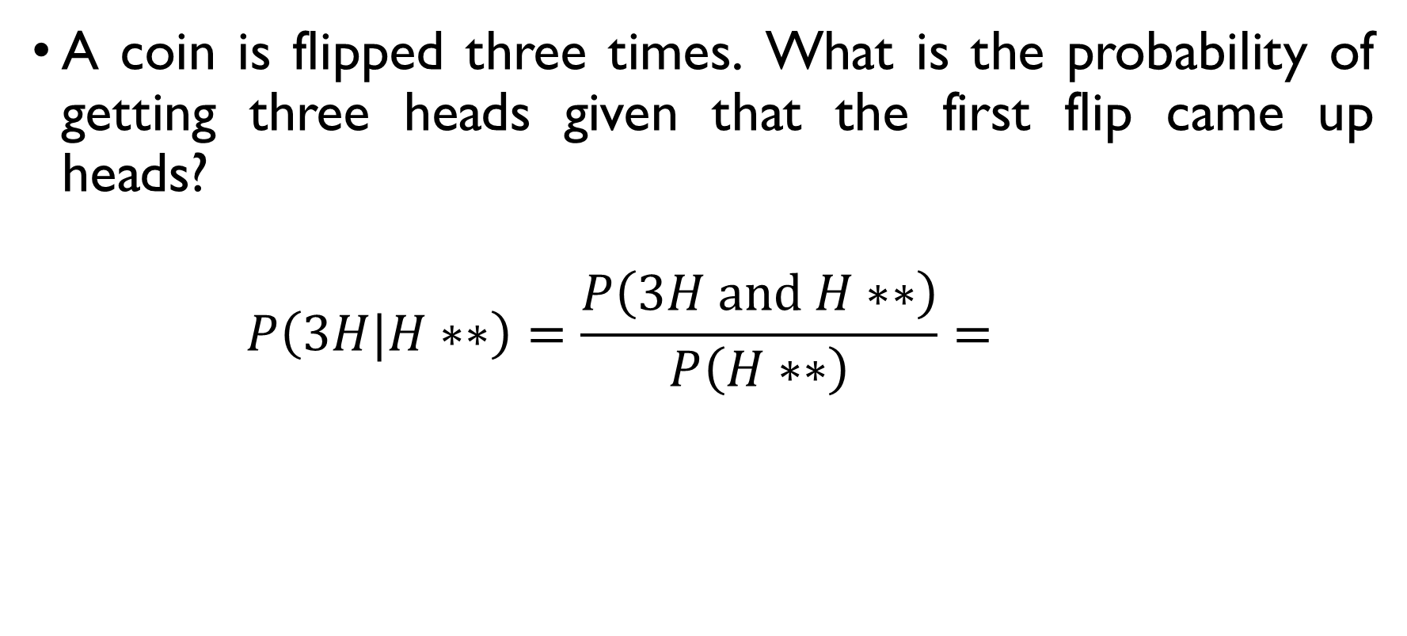
coins
A coin is flipped three times. What is the probability of getting three heads given that the first flip came up heads?
$$P\left(3H|H∗∗\right)=\frac{P\left(3H and H∗∗\right)}{P\left(H∗∗\right)}=\frac{2}{2^{3}}=\frac{1}{4}$$
$$P\left(3H and H∗∗\right)=\frac{1}{2^{3}}, P\left(H∗∗\right)=\frac{2^{2}}{2^{3}}=\frac{1}{2}$$

Slide 40
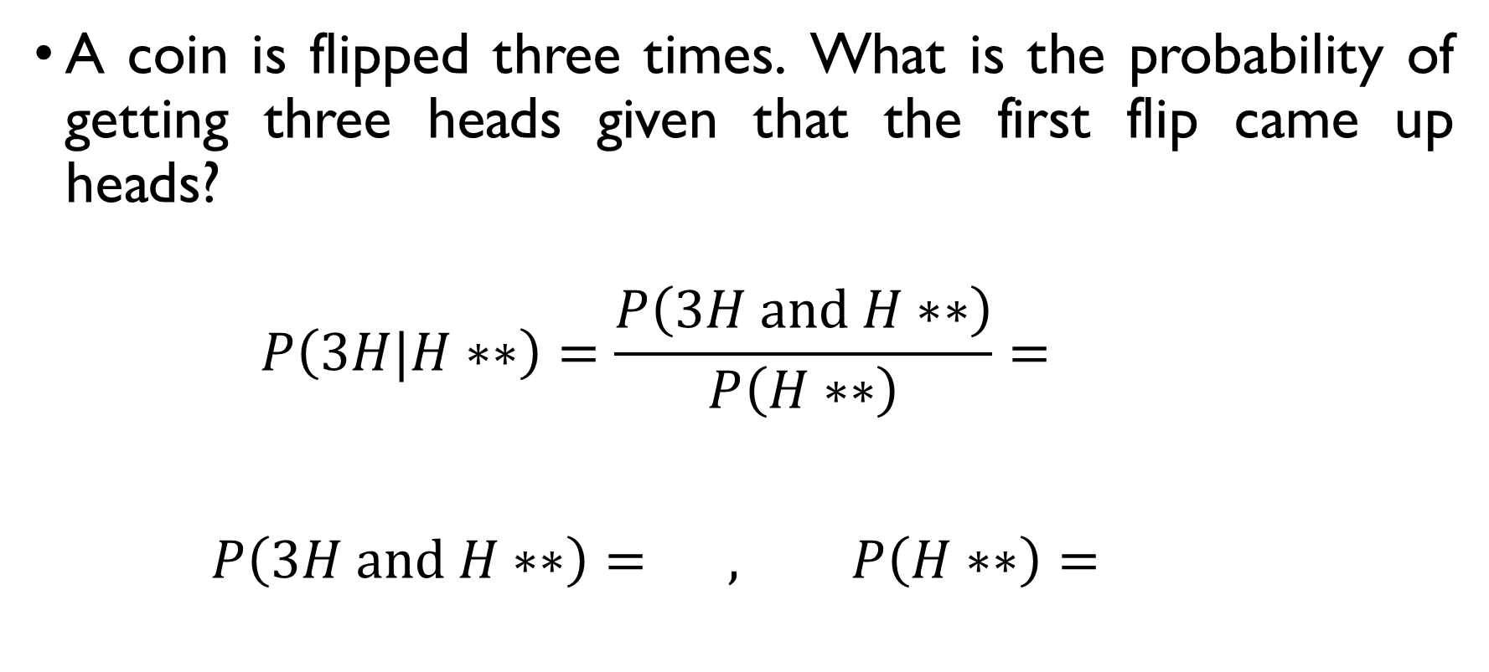
coins
A coin is flipped three times. What is the probability of getting three heads given that the first flip came up heads?
$$P\left(3H|H∗∗\right)=\frac{P\left(3H and H∗∗\right)}{P\left(H∗∗\right)}=\frac{2}{2^{3}}=\frac{1}{4}$$
$$P\left(3H and H∗∗\right)=\frac{1}{2^{3}}, P\left(H∗∗\right)=\frac{2^{2}}{2^{3}}=\frac{1}{2}$$

Slide 41
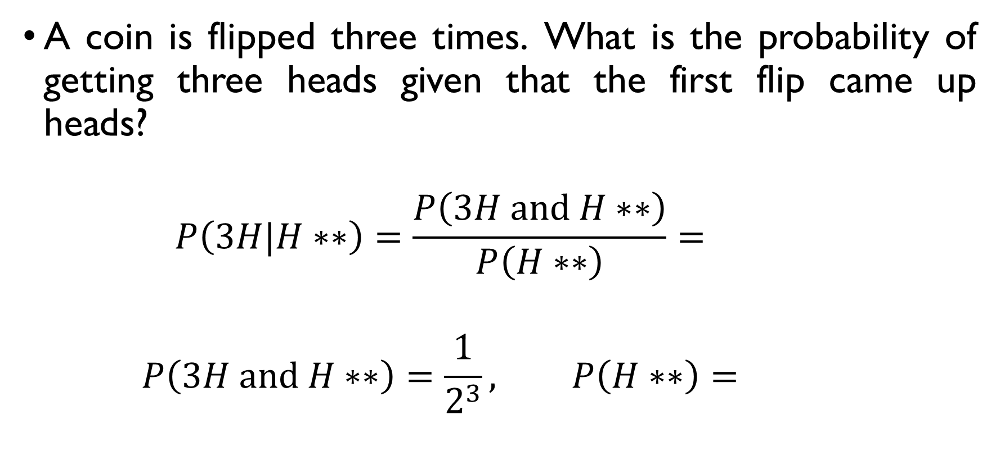
coins
A coin is flipped three times. What is the probability of getting three heads given that the first flip came up heads?
$$P\left(3H|H∗∗\right)=\frac{P\left(3H and H∗∗\right)}{P\left(H∗∗\right)}=\frac{2}{2^{3}}=\frac{1}{4}$$
$$P\left(3H and H∗∗\right)=\frac{1}{2^{3}}, P\left(H∗∗\right)=\frac{2^{2}}{2^{3}}=\frac{1}{2}$$

Slide 42
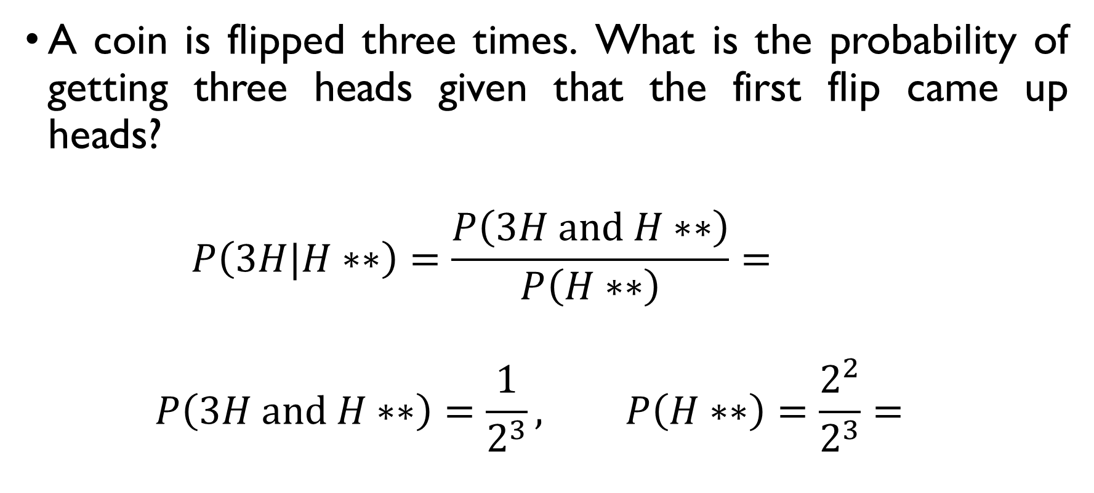
coins
A coin is flipped three times. What is the probability of getting three heads given that the first flip came up heads?
$$P\left(3H|H∗∗\right)=\frac{P\left(3H and H∗∗\right)}{P\left(H∗∗\right)}=\frac{2}{2^{3}}=\frac{1}{4}$$
$$P\left(3H and H∗∗\right)=\frac{1}{2^{3}}, P\left(H∗∗\right)=\frac{2^{2}}{2^{3}}=\frac{1}{2}$$

Slide 43
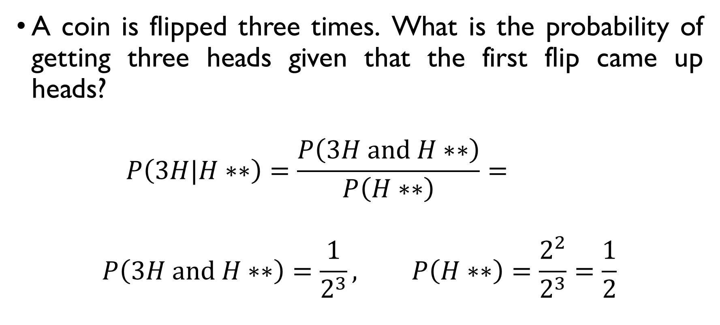
coins
A coin is flipped three times. What is the probability of getting three heads given that the first flip came up heads?
$$P\left(3H|H∗∗\right)=\frac{P\left(3H and H∗∗\right)}{P\left(H∗∗\right)}=\frac{2}{2^{3}}=\frac{1}{4}$$
$$P\left(3H and H∗∗\right)=\frac{1}{2^{3}}, P\left(H∗∗\right)=\frac{2^{2}}{2^{3}}=\frac{1}{2}$$

Slide 44
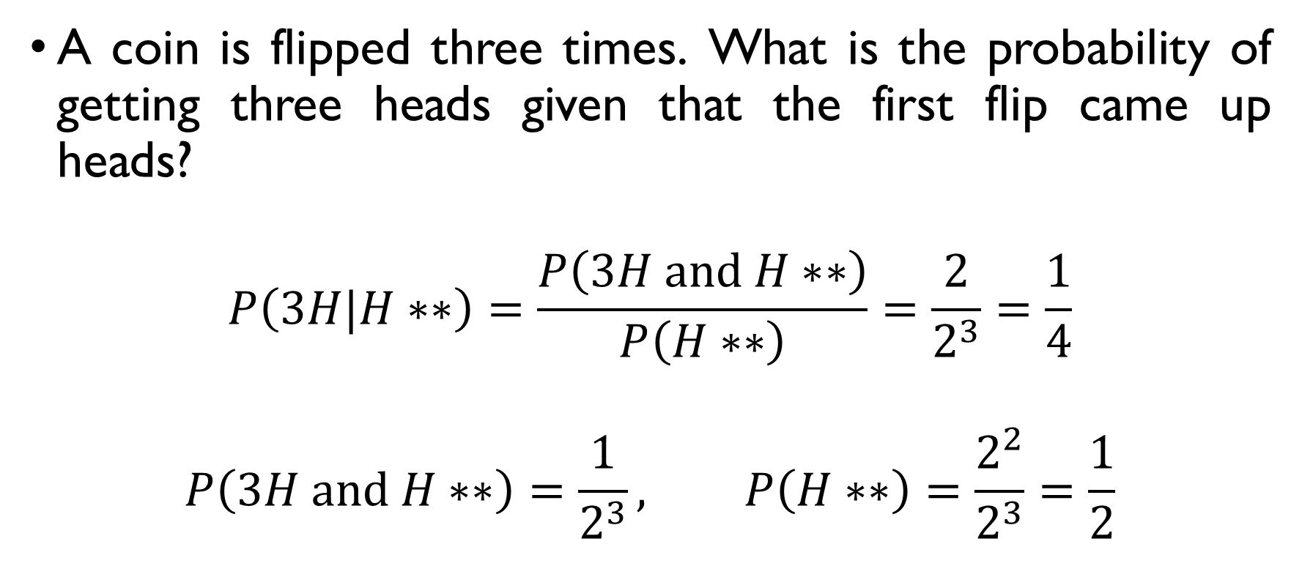
coins
A coin is flipped three times. What is the probability of getting three heads given that the first flip came up heads?
$$P\left(3H|H∗∗\right)=\frac{P\left(3H and H∗∗\right)}{P\left(H∗∗\right)}=\frac{2}{2^{3}}=\frac{1}{4}$$
$$P\left(3H and H∗∗\right)=\frac{1}{2^{3}}, P\left(H∗∗\right)=\frac{2^{2}}{2^{3}}=\frac{1}{2}$$

Slide 45
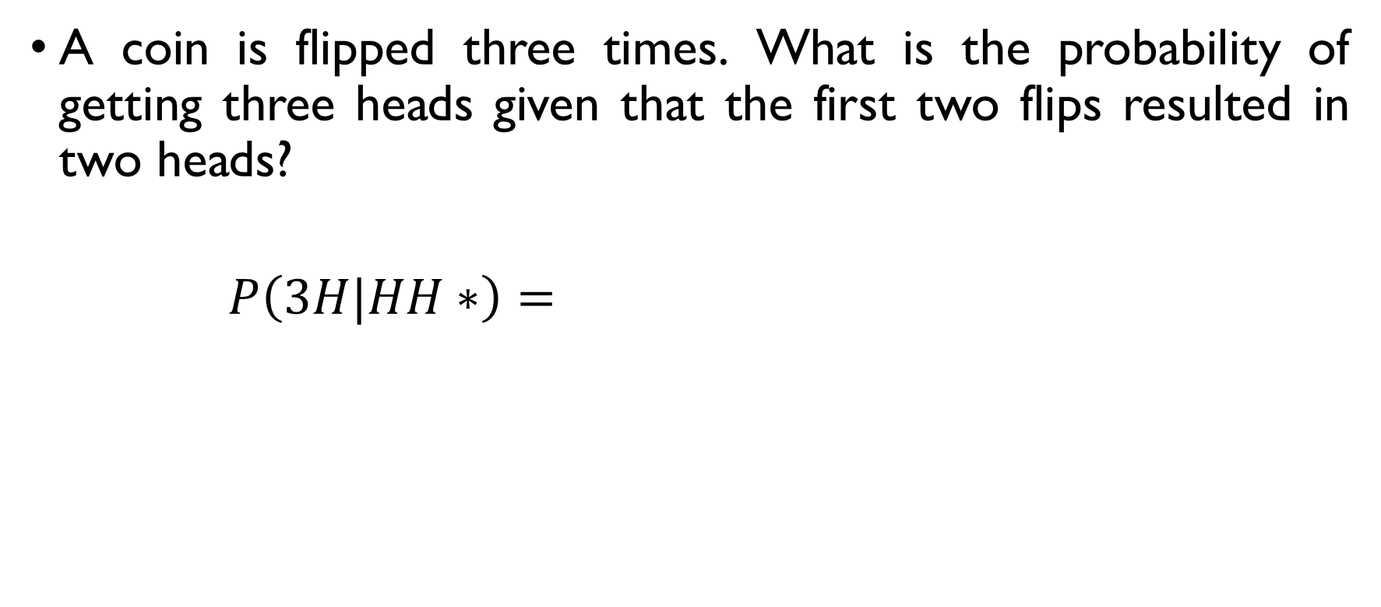
coins
A coin is flipped three times. What is the probability of getting three heads given that the first two flips resulted in two heads?
$$P\left(3H|HH∗\right)=\frac{P\left(3H and HH∗\right)}{P\left(HH∗\right)}=\frac{4}{2^{3}}=\frac{1}{2}$$
$$P\left(3H and HH∗\right)=\frac{1}{2^{3}}, P\left(HH∗\right)=\frac{2}{2^{3}}=\frac{1}{4}$$

Slide 46
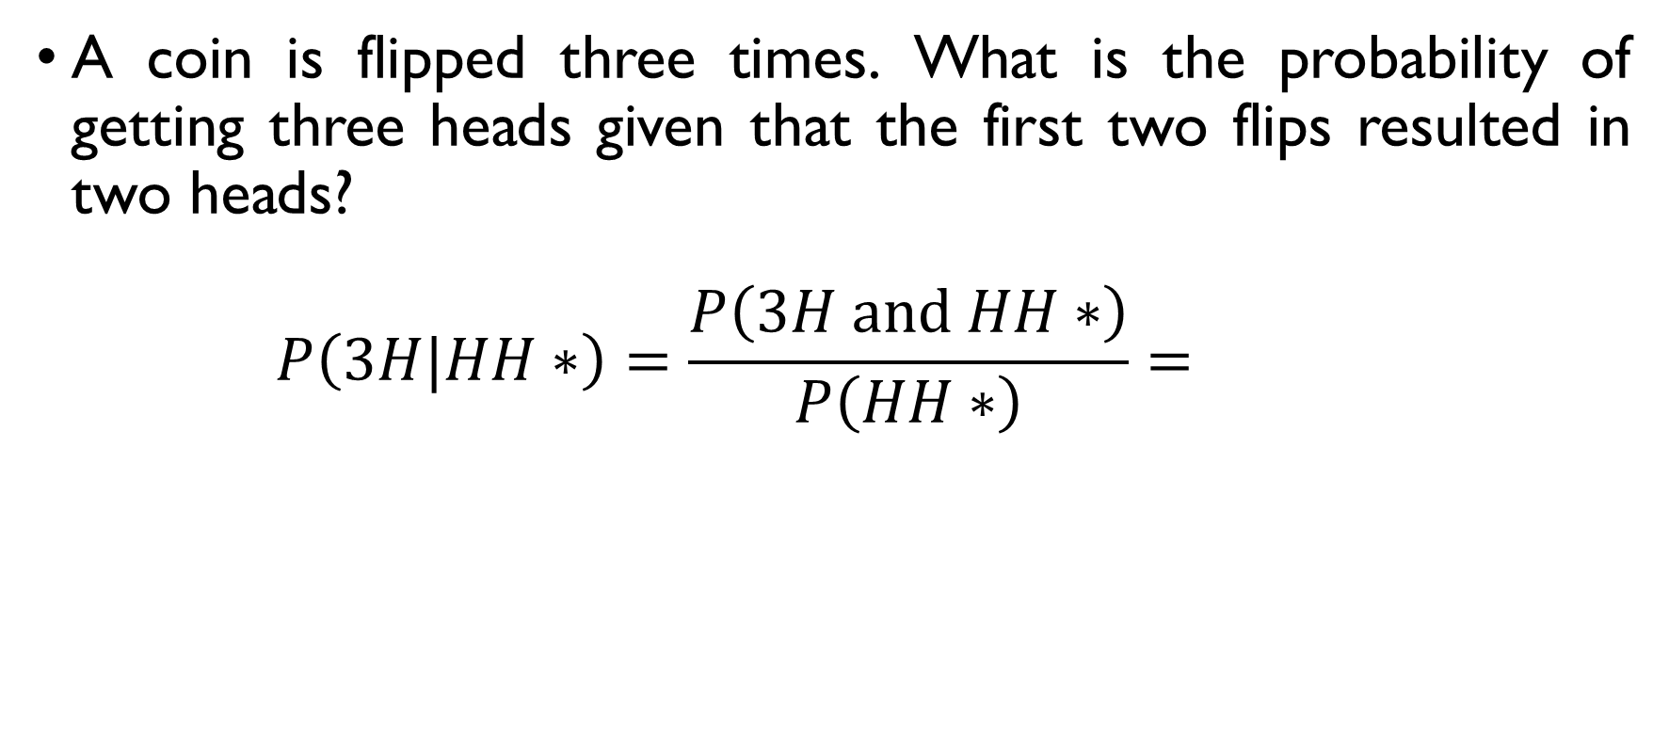
coins
A coin is flipped three times. What is the probability of getting three heads given that the first two flips resulted in two heads?
$$P\left(3H|HH∗\right)=\frac{P\left(3H and HH∗\right)}{P\left(HH∗\right)}=\frac{4}{2^{3}}=\frac{1}{2}$$
$$P\left(3H and HH∗\right)=\frac{1}{2^{3}}, P\left(HH∗\right)=\frac{2}{2^{3}}=\frac{1}{4}$$

Slide 47
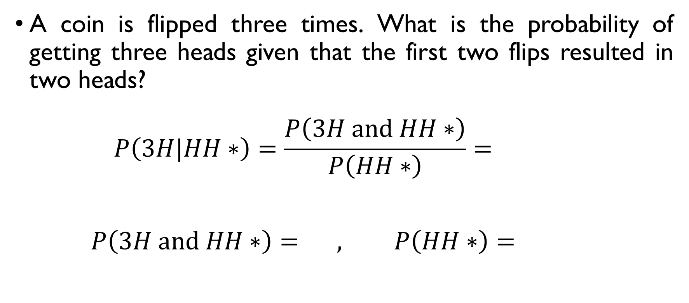
coins
A coin is flipped three times. What is the probability of getting three heads given that the first two flips resulted in two heads?
$$P\left(3H|HH∗\right)=\frac{P\left(3H and HH∗\right)}{P\left(HH∗\right)}=\frac{4}{2^{3}}=\frac{1}{2}$$
$$P\left(3H and HH∗\right)=\frac{1}{2^{3}}, P\left(HH∗\right)=\frac{2}{2^{3}}=\frac{1}{4}$$

Slide 48
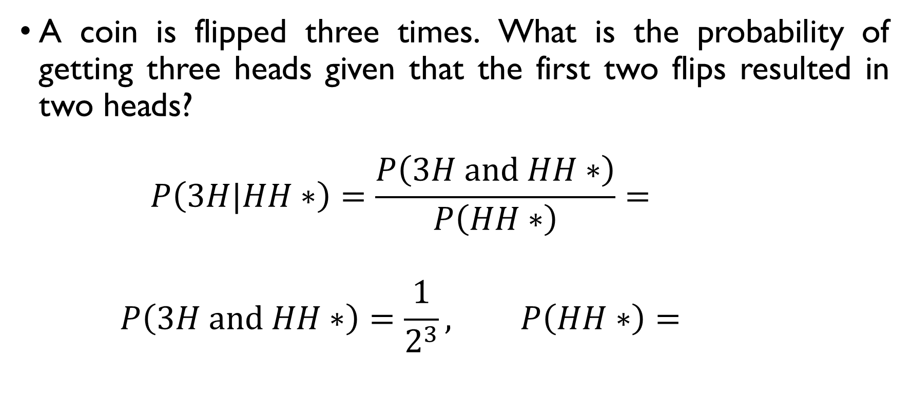
coins
A coin is flipped three times. What is the probability of getting three heads given that the first two flips resulted in two heads?
$$P\left(3H|HH∗\right)=\frac{P\left(3H and HH∗\right)}{P\left(HH∗\right)}=\frac{4}{2^{3}}=\frac{1}{2}$$
$$P\left(3H and HH∗\right)=\frac{1}{2^{3}}, P\left(HH∗\right)=\frac{2}{2^{3}}=\frac{1}{4}$$

Slide 49
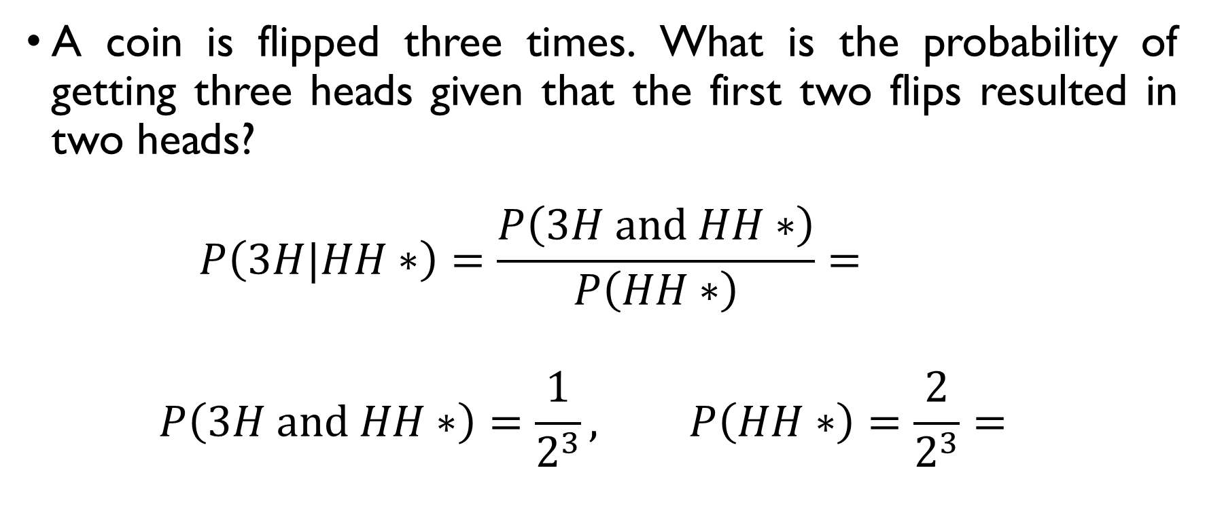
coins
A coin is flipped three times. What is the probability of getting three heads given that the first two flips resulted in two heads?
$$P\left(3H|HH∗\right)=\frac{P\left(3H and HH∗\right)}{P\left(HH∗\right)}=\frac{4}{2^{3}}=\frac{1}{2}$$
$$P\left(3H and HH∗\right)=\frac{1}{2^{3}}, P\left(HH∗\right)=\frac{2}{2^{3}}=\frac{1}{4}$$

Slide 50
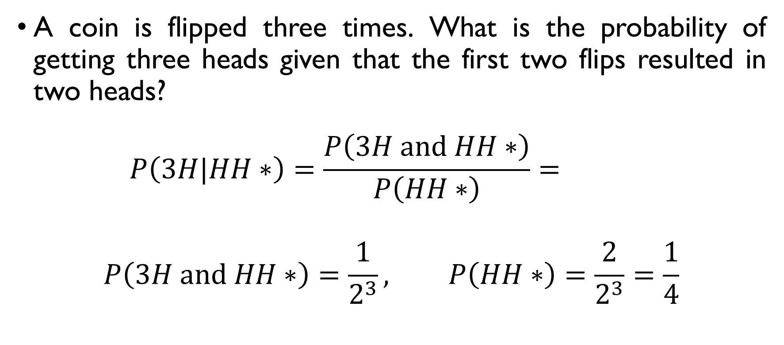
coins
A coin is flipped three times. What is the probability of getting three heads given that the first two flips resulted in two heads?
$$P\left(3H|HH∗\right)=\frac{P\left(3H and HH∗\right)}{P\left(HH∗\right)}=\frac{4}{2^{3}}=\frac{1}{2}$$
$$P\left(3H and HH∗\right)=\frac{1}{2^{3}}, P\left(HH∗\right)=\frac{2}{2^{3}}=\frac{1}{4}$$

Slide 51
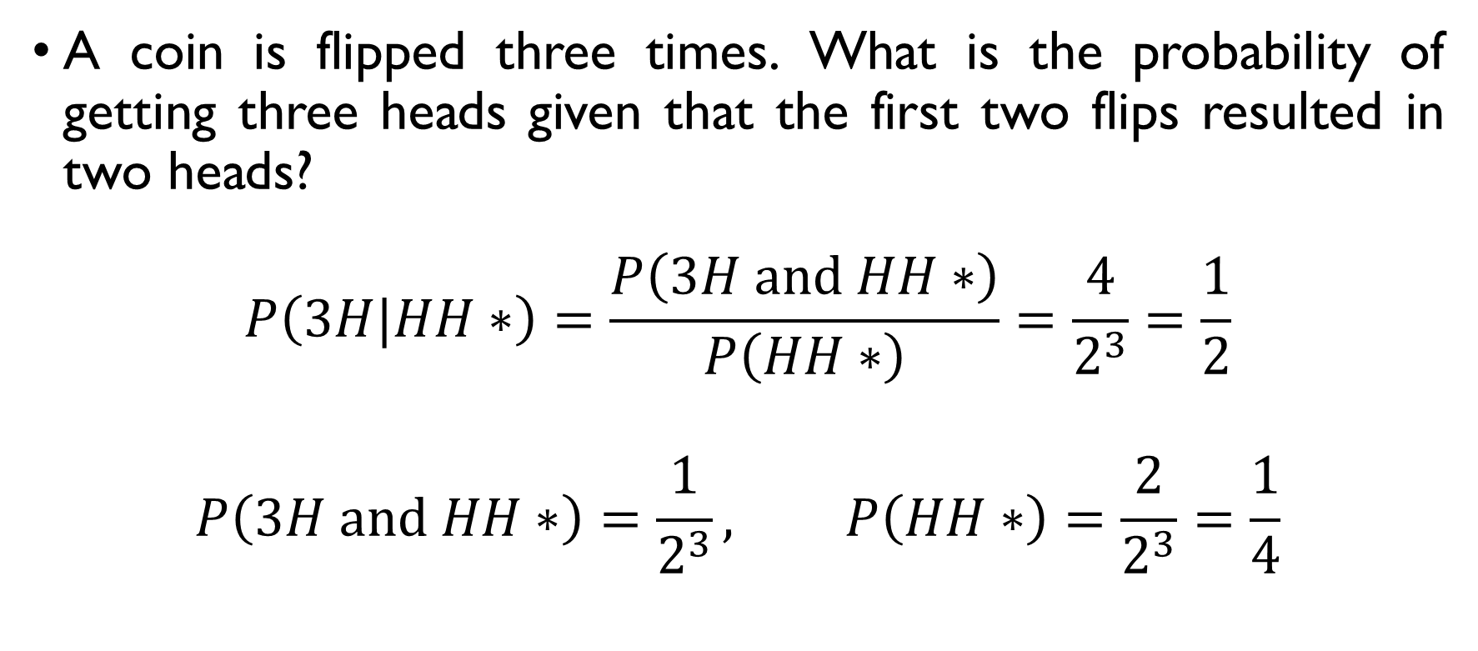
coins
A coin is flipped three times. What is the probability of getting three heads given that the first two flips resulted in two heads?
$$P\left(3H|HH∗\right)=\frac{P\left(3H and HH∗\right)}{P\left(HH∗\right)}=\frac{4}{2^{3}}=\frac{1}{2}$$
$$P\left(3H and HH∗\right)=\frac{1}{2^{3}}, P\left(HH∗\right)=\frac{2}{2^{3}}=\frac{1}{4}$$

Slide 52
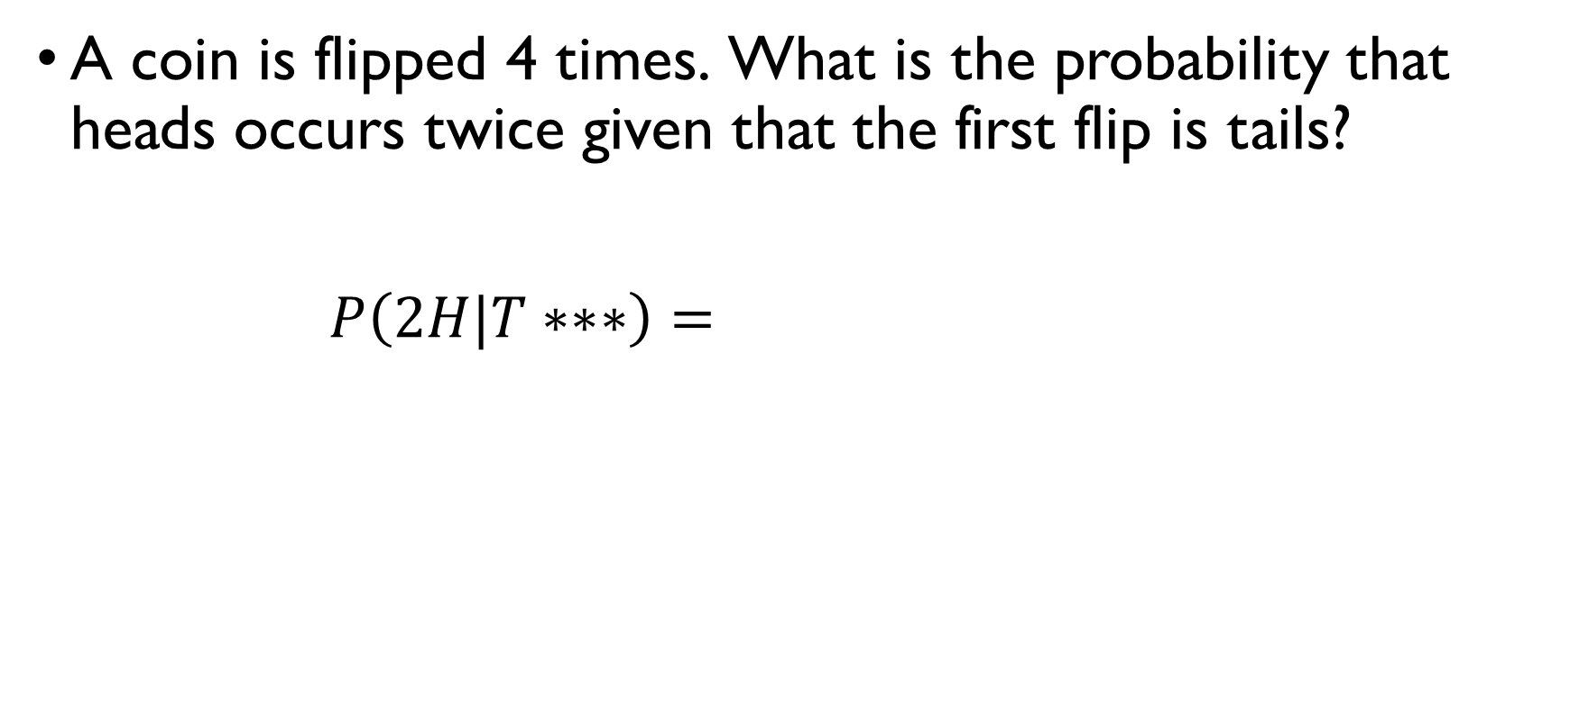
coins
A coin is flipped 4 times. What is the probability that heads occurs twice given that the first flip is tails?
$$P\left(2H|T∗∗∗\right)=\frac{P\left(2H and T∗∗∗\right)}{P\left(T∗∗∗\right)}=\frac{3}{8}$$
$$P\left(2H and T∗∗∗\right)=\frac{3}{2^{4}}, P\left(T∗∗∗\right)=\frac{2^{3}}{2^{4}}=\frac{1}{2}$$

Slide 53
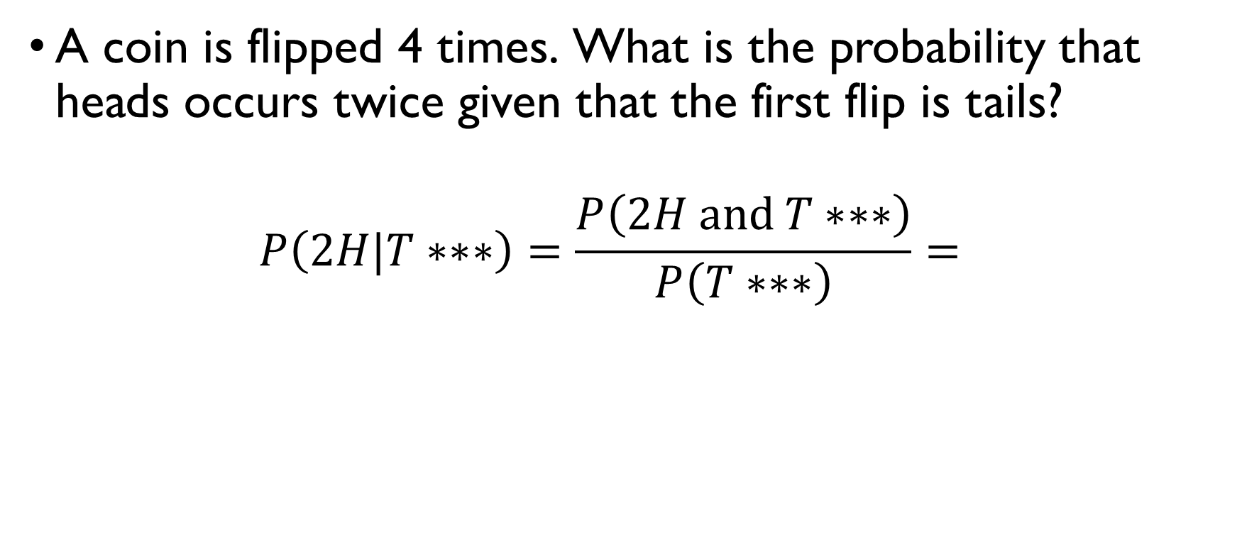
coins
A coin is flipped 4 times. What is the probability that heads occurs twice given that the first flip is tails?
$$P\left(2H|T∗∗∗\right)=\frac{P\left(2H and T∗∗∗\right)}{P\left(T∗∗∗\right)}=\frac{3}{8}$$
$$P\left(2H and T∗∗∗\right)=\frac{3}{2^{4}}, P\left(T∗∗∗\right)=\frac{2^{3}}{2^{4}}=\frac{1}{2}$$

Slide 54
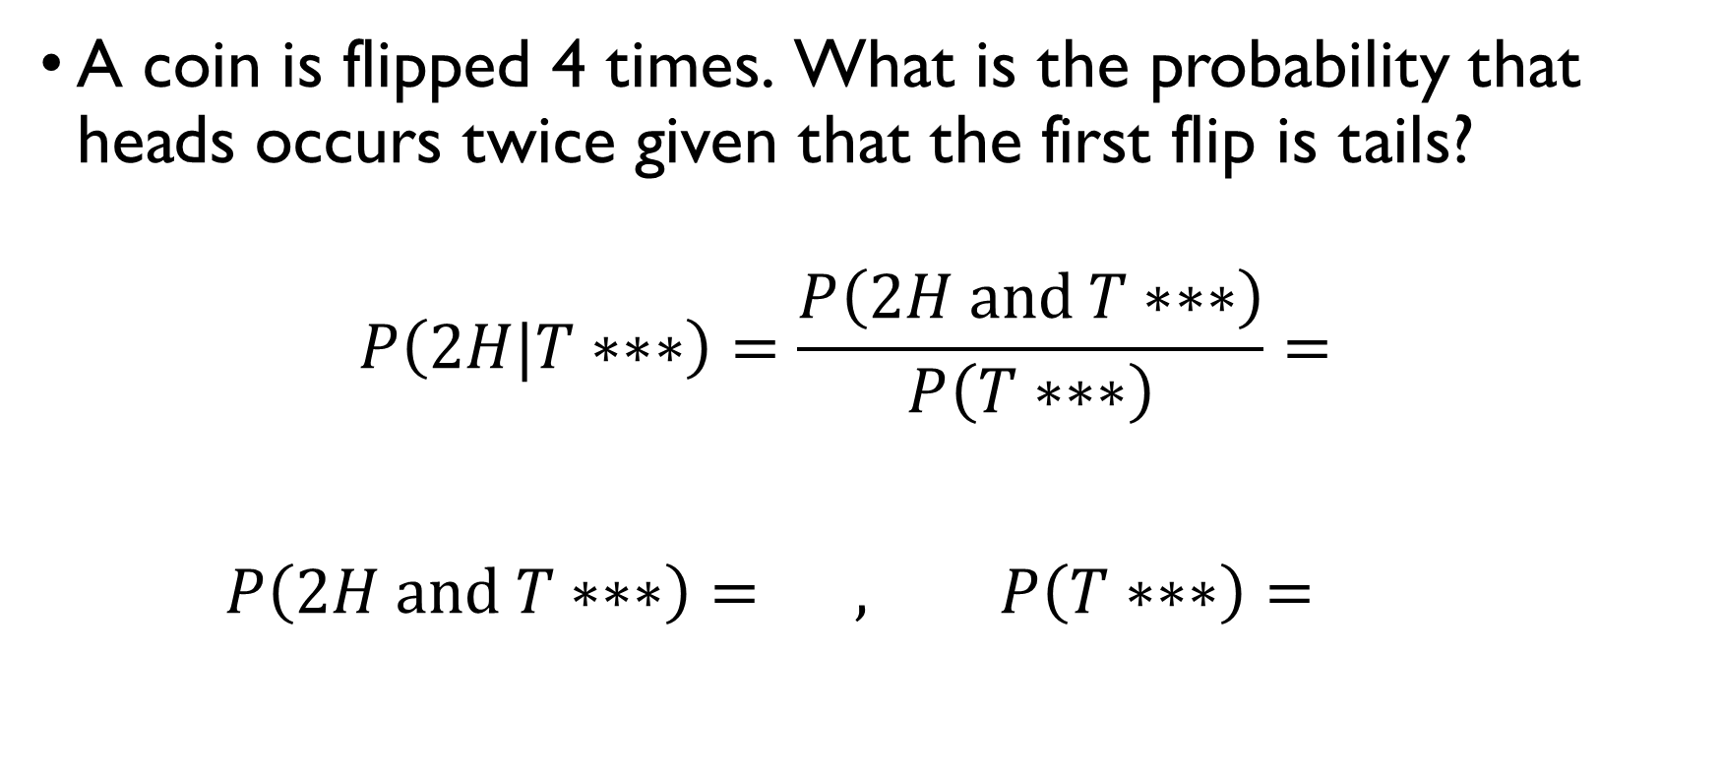
coins
A coin is flipped 4 times. What is the probability that heads occurs twice given that the first flip is tails?
$$P\left(2H|T∗∗∗\right)=\frac{P\left(2H and T∗∗∗\right)}{P\left(T∗∗∗\right)}=\frac{3}{8}$$
$$P\left(2H and T∗∗∗\right)=\frac{3}{2^{4}}, P\left(T∗∗∗\right)=\frac{2^{3}}{2^{4}}=\frac{1}{2}$$

Slide 55
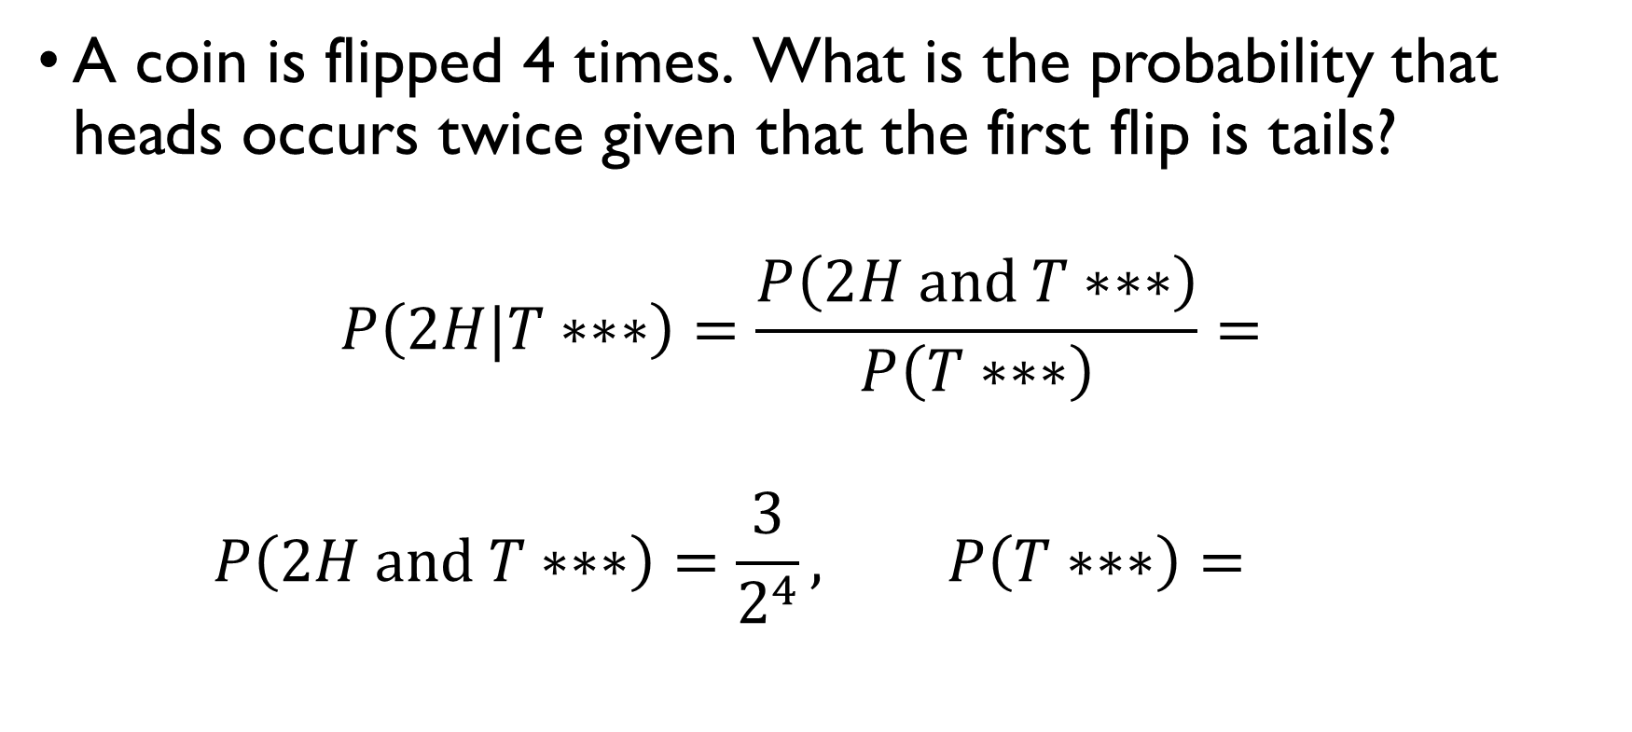
coins
A coin is flipped 4 times. What is the probability that heads occurs twice given that the first flip is tails?
$$P\left(2H|T∗∗∗\right)=\frac{P\left(2H and T∗∗∗\right)}{P\left(T∗∗∗\right)}=\frac{3}{8}$$
$$P\left(2H and T∗∗∗\right)=\frac{3}{2^{4}}, P\left(T∗∗∗\right)=\frac{2^{3}}{2^{4}}=\frac{1}{2}$$

Slide 56

coins
A coin is flipped 4 times. What is the probability that heads occurs twice given that the first flip is tails?
$$P\left(2H|T∗∗∗\right)=\frac{P\left(2H and T∗∗∗\right)}{P\left(T∗∗∗\right)}=\frac{3}{8}$$
$$P\left(2H and T∗∗∗\right)=\frac{3}{2^{4}}, P\left(T∗∗∗\right)=\frac{2^{3}}{2^{4}}=\frac{1}{2}$$

Slide 57

coins
A coin is flipped 4 times. What is the probability that heads occurs twice given that the first flip is tails?
$$P\left(2H|T∗∗∗\right)=\frac{P\left(2H and T∗∗∗\right)}{P\left(T∗∗∗\right)}=\frac{3}{8}$$
$$P\left(2H and T∗∗∗\right)=\frac{3}{2^{4}}, P\left(T∗∗∗\right)=\frac{2^{3}}{2^{4}}=\frac{1}{2}$$

Slide 58

coins
A coin is flipped 4 times. What is the probability that heads occurs twice given that the first flip is tails?
$$P\left(2H|T∗∗∗\right)=\frac{P\left(2H and T∗∗∗\right)}{P\left(T∗∗∗\right)}=\frac{3}{8}$$
$$P\left(2H and T∗∗∗\right)=\frac{3}{2^{4}}, P\left(T∗∗∗\right)=\frac{2^{3}}{2^{4}}=\frac{1}{2}$$

Slide 59
The law of total probability

Slide 60

marketing
1 in 50 potential buyers sees a magazine ad $\left(M\right)$, 1 in 5 sees a TV ad $\left(T\right)$and 1 in 100 sees both. One in 3 purchases the product after seeing the ad, 1 in 10 without seeing it. What is the probability that a randomly selected potential customer will purchase the product ($P$)?
$$P\left(P\right)=P\left(P|A\right)⋅P\left(A\right)+P\left(P|\overline{A}\right)⋅P\left(\overline{A}\right)=$$
$$=P\left(P|M∪T\right)⋅P\left(M∪T\right)+P\left(P|\overline{M∪T}\right)⋅P\left(\overline{M∪T}\right)=$$
$$=\frac{1}{3}⋅0.21+0.1⋅\left(1−0.21\right)=0.07+0.079=0.149$$
$$P\left(M∪T\right)=P\left(M\right)+P\left(T\right)−P\left(M∩T\right)=0.02+0.2−0.01=0.21$$

Slide 61

marketing
1 in 50 potential buyers sees a magazine ad $\left(M\right)$, 1 in 5 sees a TV ad $\left(T\right)$and 1 in 100 sees both. One in 3 purchases the product after seeing the ad, 1 in 10 without seeing it. What is the probability that a randomly selected potential customer will purchase the product ($P$)?
$$P\left(P\right)=P\left(P|A\right)⋅P\left(A\right)+P\left(P|\overline{A}\right)⋅P\left(\overline{A}\right)=$$
$$=P\left(P|M∪T\right)⋅P\left(M∪T\right)+P\left(P|\overline{M∪T}\right)⋅P\left(\overline{M∪T}\right)=$$
$$=\frac{1}{3}⋅0.21+0.1⋅\left(1−0.21\right)=0.07+0.079=0.149$$
$$P\left(M∪T\right)=P\left(M\right)+P\left(T\right)−P\left(M∩T\right)=0.02+0.2−0.01=0.21$$

Slide 62

marketing
1 in 50 potential buyers sees a magazine ad $\left(M\right)$, 1 in 5 sees a TV ad $\left(T\right)$and 1 in 100 sees both. One in 3 purchases the product after seeing the ad, 1 in 10 without seeing it. What is the probability that a randomly selected potential customer will purchase the product ($P$)?
$$P\left(P\right)=P\left(P|A\right)⋅P\left(A\right)+P\left(P|\overline{A}\right)⋅P\left(\overline{A}\right)=$$
$$=P\left(P|M∪T\right)⋅P\left(M∪T\right)+P\left(P|\overline{M∪T}\right)⋅P\left(\overline{M∪T}\right)=$$
$$=\frac{1}{3}⋅0.21+0.1⋅\left(1−0.21\right)=0.07+0.079=0.149$$
$$P\left(M∪T\right)=P\left(M\right)+P\left(T\right)−P\left(M∩T\right)=0.02+0.2−0.01=0.21$$

Slide 63

marketing
1 in 50 potential buyers sees a magazine ad $\left(M\right)$, 1 in 5 sees a TV ad $\left(T\right)$and 1 in 100 sees both. One in 3 purchases the product after seeing the ad, 1 in 10 without seeing it. What is the probability that a randomly selected potential customer will purchase the product ($P$)?
$$P\left(P\right)=P\left(P|A\right)⋅P\left(A\right)+P\left(P|\overline{A}\right)⋅P\left(\overline{A}\right)=$$
$$=P\left(P|M∪T\right)⋅P\left(M∪T\right)+P\left(P|\overline{M∪T}\right)⋅P\left(\overline{M∪T}\right)=$$
$$=\frac{1}{3}⋅0.21+0.1⋅\left(1−0.21\right)=0.07+0.079=0.149$$
$$P\left(M∪T\right)=P\left(M\right)+P\left(T\right)−P\left(M∩T\right)=0.02+0.2−0.01=0.21$$

Slide 64

marketing
1 in 50 potential buyers sees a magazine ad $\left(M\right)$, 1 in 5 sees a TV ad $\left(T\right)$and 1 in 100 sees both. One in 3 purchases the product after seeing the ad, 1 in 10 without seeing it. What is the probability that a randomly selected potential customer will purchase the product ($P$)?
$$P\left(P\right)=P\left(P|A\right)⋅P\left(A\right)+P\left(P|\overline{A}\right)⋅P\left(\overline{A}\right)=$$
$$=P\left(P|M∪T\right)⋅P\left(M∪T\right)+P\left(P|\overline{M∪T}\right)⋅P\left(\overline{M∪T}\right)=$$
$$=\frac{1}{3}⋅0.21+0.1⋅\left(1−0.21\right)=0.07+0.079=0.149$$
$$P\left(M∪T\right)=P\left(M\right)+P\left(T\right)−P\left(M∩T\right)=0.02+0.2−0.01=0.21$$

Slide 65

marketing
1 in 50 potential buyers sees a magazine ad $\left(M\right)$, 1 in 5 sees a TV ad $\left(T\right)$and 1 in 100 sees both. One in 3 purchases the product after seeing the ad, 1 in 10 without seeing it. What is the probability that a randomly selected potential customer will purchase the product ($P$)?
$$P\left(P\right)=P\left(P|A\right)⋅P\left(A\right)+P\left(P|\overline{A}\right)⋅P\left(\overline{A}\right)=$$
$$=P\left(P|M∪T\right)⋅P\left(M∪T\right)+P\left(P|\overline{M∪T}\right)⋅P\left(\overline{M∪T}\right)=$$
$$=\frac{1}{3}⋅0.21+0.1⋅\left(1−0.21\right)=0.07+0.079=0.149$$
$$P\left(M∪T\right)=P\left(M\right)+P\left(T\right)−P\left(M∩T\right)=0.02+0.2−0.01=0.21$$

Slide 66

marketing
1 in 50 potential buyers sees a magazine ad $\left(M\right)$, 1 in 5 sees a TV ad $\left(T\right)$and 1 in 100 sees both. One in 3 purchases the product after seeing the ad, 1 in 10 without seeing it. What is the probability that a randomly selected potential customer will purchase the product ($P$)?
$$P\left(P\right)=P\left(P|A\right)⋅P\left(A\right)+P\left(P|\overline{A}\right)⋅P\left(\overline{A}\right)=$$
$$=P\left(P|M∪T\right)⋅P\left(M∪T\right)+P\left(P|\overline{M∪T}\right)⋅P\left(\overline{M∪T}\right)=$$
$$=\frac{1}{3}⋅0.21+0.1⋅\left(1−0.21\right)=0.07+0.079=0.149$$
$$P\left(M∪T\right)=P\left(M\right)+P\left(T\right)−P\left(M∩T\right)=0.02+0.2−0.01=0.21$$

Slide 67

marketing
1 in 50 potential buyers sees a magazine ad $\left(M\right)$, 1 in 5 sees a TV ad $\left(T\right)$and 1 in 100 sees both. One in 3 purchases the product after seeing the ad, 1 in 10 without seeing it. What is the probability that a randomly selected potential customer will purchase the product ($P$)?
$$P\left(P\right)=P\left(P|A\right)⋅P\left(A\right)+P\left(P|\overline{A}\right)⋅P\left(\overline{A}\right)=$$
$$=P\left(P|M∪T\right)⋅P\left(M∪T\right)+P\left(P|\overline{M∪T}\right)⋅P\left(\overline{M∪T}\right)=$$
$$=\frac{1}{3}⋅0.21+0.1⋅\left(1−0.21\right)=0.07+0.079=0.149$$
$$P\left(M∪T\right)=P\left(M\right)+P\left(T\right)−P\left(M∩T\right)=0.02+0.2−0.01=0.21$$

Slide 68
Bayes’ rule

Slide 69

A test for disease
Imagine that a rare disease affects 1% of the population
$$P\left(D\right)=0.01$$
A 90% - accurate test has been developed to detect the disease
$$P\left(+|D\right)=0.9, P\left(−|no D\right)=0.9$$
You test positive. How much should you be worried?
$$P\left(D |+\right)= ?$$

Slide 70

A test for disease
Imagine that a rare disease affects 1% of the population
$$P\left(D\right)=0.01$$
A 90% - accurate test has been developed to detect the disease
$$P\left(+|D\right)=0.9, P\left(−|no D\right)=0.9$$
You test positive. How much should you be worried?
$$P\left(D |+\right)= ?$$

Slide 71

A test for disease
Imagine that a rare disease affects 1% of the population
$$P\left(D\right)=0.01$$
A 90% - accurate test has been developed to detect the disease
$$P\left(+|D\right)=0.9, P\left(−|no D\right)=0.9$$
You test positive. How much should you be worried?
$$P\left(D |+\right)= ?$$

Slide 72

A test for disease
Imagine that a rare disease affects 1% of the population
$$P\left(D\right)=0.01$$
A 90% - accurate test has been developed to detect the disease
$$P\left(+|D\right)=0.9, P\left(−|no D\right)=0.9$$
You test positive. How much should you be worried?
$$P\left(D |+\right)= ?$$

Slide 73

A test for disease
Imagine that a rare disease affects 1% of the population
$$P\left(D\right)=0.01$$
A 90% - accurate test has been developed to detect the disease
$$P\left(+|D\right)=0.9, P\left(−|no D\right)=0.9$$
You test positive. How much should you be worried?
$$P\left(D |+\right)= ?$$

Slide 74

A test for disease
Imagine that a rare disease affects 1% of the population
$$P\left(D\right)=0.01$$
A 90% - accurate test has been developed to detect the disease
$$P\left(+|D\right)=0.9, P\left(−|no D\right)=0.9$$
You test positive. How much should you be worried?
$$P\left(D |+\right)= ?$$

Slide 75



How reliable the test is?
$$P\left(D\right)=0.01, P\left(+ | D\right)=P\left(− | no D\right)=0.9$$
REALITY / TEST RESULTS | POSITIVE | NEGATIVE
HEALTHY | FALSE POSITIVES 10% of 99% healthy people = 9.9% of the population | TRUE NEGATIVES 90% of 99% healthy people = 89.1% of the population
ILL | TRUE POSITIVES 90% of 1% ill people = 0.9% of the population | FALSE NEGATIVES 10% of 1% ill people = 0.1% of the population
$$≈92\%$$
$$≈8\%$$

Slide 76

Same thing, but in terms of probability
$$P\left(D\right)=0.01, P\left(+ | D\right)=P\left(− | no D\right)=0.9, P\left(D |+\right)= ?$$
$$P\left(D |+\right)=\frac{P\left(+ and D\right)}{P\left(+\right)}=\frac{0.009}{0.108}≈0.083$$
$$P\left(+ | D\right)=\frac{P\left(+ and D\right)}{P\left(D\right)} → P\left(+ and D\right)=P\left(+ | D\right)⋅P\left(D\right)=0.009$$
$$P\left(+\right)=P\left(+ | D\right)⋅P\left(D\right)+P\left(+ | no D\right)⋅P\left(no D\right)=$$
$$=0.9⋅0.01+0.1⋅0.99=0.108$$

Slide 77

Same thing, but in terms of probability
$$P\left(D\right)=0.01, P\left(+ | D\right)=P\left(− | no D\right)=0.9, P\left(D |+\right)= ?$$
$$P\left(D |+\right)=\frac{P\left(+ and D\right)}{P\left(+\right)}=\frac{0.009}{0.108}≈0.083$$
$$P\left(+ | D\right)=\frac{P\left(+ and D\right)}{P\left(D\right)} → P\left(+ and D\right)=P\left(+ | D\right)⋅P\left(D\right)=0.009$$
$$P\left(+\right)=P\left(+ | D\right)⋅P\left(D\right)+P\left(+ | no D\right)⋅P\left(no D\right)=$$
$$=0.9⋅0.01+0.1⋅0.99=0.108$$

Slide 78

Same thing, but in terms of probability
$$P\left(D\right)=0.01, P\left(+ | D\right)=P\left(− | no D\right)=0.9, P\left(D |+\right)= ?$$
$$P\left(D |+\right)=\frac{P\left(+ and D\right)}{P\left(+\right)}=\frac{0.009}{0.108}≈0.083$$
$$P\left(+ | D\right)=\frac{P\left(+ and D\right)}{P\left(D\right)} → P\left(+ and D\right)=P\left(+ | D\right)⋅P\left(D\right)=0.009$$
$$P\left(+\right)=P\left(+ | D\right)⋅P\left(D\right)+P\left(+ | no D\right)⋅P\left(no D\right)=$$
$$=0.9⋅0.01+0.1⋅0.99=0.108$$

Slide 79

Same thing, but in terms of probability
$$P\left(D\right)=0.01, P\left(+ | D\right)=P\left(− | no D\right)=0.9, P\left(D |+\right)= ?$$
$$P\left(D |+\right)=\frac{P\left(+ and D\right)}{P\left(+\right)}=\frac{0.009}{0.108}≈0.083$$
$$P\left(+ | D\right)=\frac{P\left(+ and D\right)}{P\left(D\right)} → P\left(+ and D\right)=P\left(+ | D\right)⋅P\left(D\right)=0.009$$
$$P\left(+\right)=P\left(+ | D\right)⋅P\left(D\right)+P\left(+ | no D\right)⋅P\left(no D\right)=$$
$$=0.9⋅0.01+0.1⋅0.99=0.108$$

Slide 80

Same thing, but in terms of probability
$$P\left(D\right)=0.01, P\left(+ | D\right)=P\left(− | no D\right)=0.9, P\left(D |+\right)= ?$$
$$P\left(D |+\right)=\frac{P\left(+ and D\right)}{P\left(+\right)}=\frac{0.009}{0.108}≈0.083$$
$$P\left(+ | D\right)=\frac{P\left(+ and D\right)}{P\left(D\right)} → P\left(+ and D\right)=P\left(+ | D\right)⋅P\left(D\right)=0.009$$
$$P\left(+\right)=P\left(+ | D\right)⋅P\left(D\right)+P\left(+ | no D\right)⋅P\left(no D\right)=$$
$$=0.9⋅0.01+0.1⋅0.99=0.108$$

Slide 81

Same thing, but in terms of probability
$$P\left(D\right)=0.01, P\left(+ | D\right)=P\left(− | no D\right)=0.9, P\left(D |+\right)= ?$$
$$P\left(D |+\right)=\frac{P\left(+ and D\right)}{P\left(+\right)}=\frac{0.009}{0.108}≈0.083$$
$$P\left(+ | D\right)=\frac{P\left(+ and D\right)}{P\left(D\right)} → P\left(+ and D\right)=P\left(+ | D\right)⋅P\left(D\right)=0.009$$
$$P\left(+\right)=P\left(+ | D\right)⋅P\left(D\right)+P\left(+ | no D\right)⋅P\left(no D\right)=$$
$$=0.9⋅0.01+0.1⋅0.99=0.108$$

Slide 82

Same thing, but in terms of probability
$$P\left(D\right)=0.01, P\left(+ | D\right)=P\left(− | no D\right)=0.9, P\left(D |+\right)= ?$$
$$P\left(D |+\right)=\frac{P\left(+ and D\right)}{P\left(+\right)}=\frac{0.009}{0.108}≈0.083$$
$$P\left(+ | D\right)=\frac{P\left(+ and D\right)}{P\left(D\right)} → P\left(+ and D\right)=P\left(+ | D\right)⋅P\left(D\right)=0.009$$
$$P\left(+\right)=P\left(+ | D\right)⋅P\left(D\right)+P\left(+ | no D\right)⋅P\left(no D\right)=$$
$$=0.9⋅0.01+0.1⋅0.99=0.108$$

Slide 83

Same thing, but in terms of probability
$$P\left(D\right)=0.01, P\left(+ | D\right)=P\left(− | no D\right)=0.9, P\left(D |+\right)= ?$$
$$P\left(D |+\right)=\frac{P\left(+ and D\right)}{P\left(+\right)}=\frac{0.009}{0.108}≈0.083$$
$$P\left(+ | D\right)=\frac{P\left(+ and D\right)}{P\left(D\right)} → P\left(+ and D\right)=P\left(+ | D\right)⋅P\left(D\right)=0.009$$
$$P\left(+\right)=P\left(+ | D\right)⋅P\left(D\right)+P\left(+ | no D\right)⋅P\left(no D\right)=$$
$$=0.9⋅0.01+0.1⋅0.99=0.108$$

Slide 84
How reliable the test is?
$$P\left(D\right)=0.01, P\left(+ | D\right)=P\left(− | no D\right)=0.9$$
REALITY / TEST RESULTS | POSITIVE | NEGATIVE
HEALTHY | FALSE POSITIVES 10% of 99% healthy people = 9.9% of the population | TRUE NEGATIVES 90% of 99% healthy people = 89.1% of the population
ILL | TRUE POSITIVES 90% of 1% ill people = 0.9% of the population | FALSE NEGATIVES 10% of 1% ill people = 0.1% of the population
$$≈92\%$$
$$≈8\%$$

Slide 85

Bayes’ rule
$$P\left(A|B\right)=\frac{P\left(AB\right)}{P\left(B\right)}=\frac{P\left(B|A\right)}{P\left(B\right)}⋅P\left(A\right)$$

Slide 86

Balls in two bowls
There are two bowls: bowl A contains 2 blue and 3 red balls, and bowl B contains 1 blue and 4 red balls. A blue ball was randomly picked from one of the bowls. What’s the probability that it was bowl A?
$$P\left(A|Blue\right)=\frac{P\left(Blue|A\right)⋅P\left(A\right)}{P\left(Blue\right)}=$$
$$=\frac{P\left(Blue|A\right)⋅P\left(A\right)}{P\left(Blue|A\right)⋅P\left(A\right)+P\left(Blue|B\right)⋅P\left(B\right)}=\frac{0.4⋅0.5}{0.4⋅0.5+0.2⋅0.5}=$$
$$=\frac{0.2}{0.3}=\frac{1}{3}$$

Slide 87

Balls in two bowls
There are two bowls: bowl A contains 2 blue and 3 red balls, and bowl B contains 1 blue and 4 red balls. A blue ball was randomly picked from one of the bowls. What’s the probability that it was bowl A?
$$P\left(A|blue\right)=\frac{P\left(Blue|A\right)⋅P\left(A\right)}{P\left(Blue\right)}=$$
$$=\frac{P\left(Blue|A\right)⋅P\left(A\right)}{P\left(Blue|A\right)⋅P\left(A\right)+P\left(Blue|B\right)⋅P\left(B\right)}=\frac{0.4⋅0.5}{0.4⋅0.5+0.2⋅0.5}=$$
$$=\frac{0.2}{0.3}=\frac{1}{3}$$

Slide 88

Balls in two bowls
There are two bowls: bowl A contains 2 blue and 3 red balls, and bowl B contains 1 blue and 4 red balls. A blue ball was randomly picked from one of the bowls. What’s the probability that it was bowl A?
$$P\left(A|blue\right)=\frac{P\left(blue|A\right)⋅P\left(A\right)}{P\left(blue\right)}=$$
$$=\frac{P\left(Blue|A\right)⋅P\left(A\right)}{P\left(Blue|A\right)⋅P\left(A\right)+P\left(Blue|B\right)⋅P\left(B\right)}=\frac{0.4⋅0.5}{0.4⋅0.5+0.2⋅0.5}=$$
$$=\frac{0.2}{0.3}=\frac{1}{3}$$

Slide 89

Balls in two bowls
There are two bowls: bowl A contains 2 blue and 3 red balls, and bowl B contains 1 blue and 4 red balls. A blue ball was randomly picked from one of the bowls. What’s the probability that it was bowl A?
$$P\left(A|blue\right)=\frac{P\left(blue|A\right)⋅P\left(A\right)}{P\left(blue\right)}=$$
$$=\frac{P\left(blue|A\right)⋅P\left(A\right)}{P\left(blue|A\right)⋅P\left(A\right)+P\left(blue|B\right)⋅P\left(B\right)}=\frac{0.4⋅0.5}{0.4⋅0.5+0.2⋅0.5}=$$
$$=\frac{0.2}{0.3}=\frac{1}{3}$$

Slide 90

Balls in two bowls
There are two bowls: bowl A contains 2 blue and 3 red balls, and bowl B contains 1 blue and 4 red balls. A blue ball was randomly picked from one of the bowls. What’s the probability that it was bowl A?
$$P\left(A|blue\right)=\frac{P\left(blue|A\right)⋅P\left(A\right)}{P\left(blue\right)}=$$
$$=\frac{P\left(blue|A\right)⋅P\left(A\right)}{P\left(blue|A\right)⋅P\left(A\right)+P\left(blue|B\right)⋅P\left(B\right)}=\frac{0.4⋅0.5}{0.4⋅0.5+0.2⋅0.5}=$$
$$=\frac{0.2}{0.3}=\frac{2}{3}$$

Slide 91

coins
A box contains 3 coins with a head on each side, 4 coins with a tail on each side, and 2 fair coins. One of these nine coins is selected at random and tossed once. Suppose that the toss does result in a head. What is the probability that the coin used for tossing was fair?
$E_{H}−$ a coin with 2 H is selected $P\left(E_{H}\right)=\frac{3}{3+4+2}=\frac{1}{3}$
$E_{T}−$ a coin with 2 T is selected $P\left(E_{T}\right)=\frac{4}{3+4+2}=\frac{4}{9}$
$E_{F}−$ a fair coin is selected $P\left(E_{F}\right)=\frac{2}{3+4+2}=\frac{2}{9}$
$$P\left(H\right)=\frac{4}{9}, P\left(E_{F}|H\right)=\frac{P\left(H|E_{F}\right)⋅P\left(E_{F}\right)}{P\left(H\right)}=\frac{\frac{1}{2}⋅\frac{2}{9}}{\frac{4}{9}}=\frac{1}{4}$$

Slide 92

coins
A box contains 3 coins with a head on each side, 4 coins with a tail on each side, and 2 fair coins. One of these nine coins is selected at random and tossed once. Suppose that the toss does result in a head. What is the probability that the coin used for tossing was fair?
$E_{H}−$ a coin with 2 H is selected $P\left(E_{H}\right)=\frac{3}{3+4+2}=\frac{1}{3}$
$E_{T}−$ a coin with 2 T is selected $P\left(E_{T}\right)=\frac{4}{3+4+2}=\frac{4}{9}$
$E_{F}−$ a fair coin is selected $P\left(E_{F}\right)=\frac{2}{3+4+2}=\frac{2}{9}$
$$P\left(H\right)=\frac{4}{9}, P\left(E_{F}|H\right)=\frac{P\left(H|E_{F}\right)⋅P\left(E_{F}\right)}{P\left(H\right)}=\frac{\frac{1}{2}⋅\frac{2}{9}}{\frac{4}{9}}=\frac{1}{4}$$

Slide 93

coins
A box contains 3 coins with a head on each side, 4 coins with a tail on each side, and 2 fair coins. One of these nine coins is selected at random and tossed once. Suppose that the toss does result in a head. What is the probability that the coin used for tossing was fair?
$E_{H}−$ a coin with 2 H is selected $P\left(E_{H}\right)=\frac{3}{3+4+2}=\frac{1}{3}$
$E_{T}−$ a coin with 2 T is selected $P\left(E_{T}\right)=\frac{4}{3+4+2}=\frac{4}{9}$
$E_{F}−$ a fair coin is selected $P\left(E_{F}\right)=\frac{2}{3+4+2}=\frac{2}{9}$
$$P\left(H\right)=\frac{4}{9}, P\left(E_{F}|H\right)=\frac{P\left(H|E_{F}\right)⋅P\left(E_{F}\right)}{P\left(H\right)}=\frac{\frac{1}{2}⋅\frac{2}{9}}{\frac{4}{9}}=\frac{1}{4}$$

Slide 94

coins
A box contains 3 coins with a head on each side, 4 coins with a tail on each side, and 2 fair coins. One of these nine coins is selected at random and tossed once. Suppose that the toss does result in a head. What is the probability that the coin used for tossing was fair?
$E_{H}−$ a coin with 2 H is selected $P\left(E_{H}\right)=\frac{3}{3+4+2}=\frac{1}{3}$
$E_{T}−$ a coin with 2 T is selected $P\left(E_{T}\right)=\frac{4}{3+4+2}=\frac{4}{9}$
$E_{F}−$ a fair coin is selected $P\left(E_{F}\right)=\frac{2}{3+4+2}=\frac{2}{9}$
$$P\left(H\right)=\frac{4}{9}, P\left(E_{F}|H\right)=\frac{P\left(H|E_{F}\right)⋅P\left(E_{F}\right)}{P\left(H\right)}=\frac{\frac{1}{2}⋅\frac{2}{9}}{\frac{4}{9}}=\frac{1}{4}$$

Slide 95

coins
A box contains 3 coins with a head on each side, 4 coins with a tail on each side, and 2 fair coins. One of these nine coins is selected at random and tossed once. Suppose that the toss does result in a head. What is the probability that the coin used for tossing was fair?
$E_{H}−$ a coin with 2 H is selected $P\left(E_{H}\right)=\frac{3}{3+4+2}=\frac{1}{3}$
$E_{T}−$ a coin with 2 T is selected $P\left(E_{T}\right)=\frac{4}{3+4+2}=\frac{4}{9}$
$E_{F}−$ a fair coin is selected $P\left(E_{F}\right)=\frac{2}{3+4+2}=\frac{2}{9}$
$$P\left(H\right)=\frac{4}{9}, P\left(E_{F}|H\right)=\frac{P\left(H|E_{F}\right)⋅P\left(E_{F}\right)}{P\left(H\right)}=\frac{\frac{1}{2}⋅\frac{2}{9}}{\frac{4}{9}}=\frac{1}{4}$$

Slide 96

coins
A box contains 3 coins with a head on each side, 4 coins with a tail on each side, and 2 fair coins. One of these nine coins is selected at random and tossed once. Suppose that the toss does result in a head. What is the probability that the coin used for tossing was fair?
$E_{H}−$ a coin with 2 H is selected $P\left(E_{H}\right)=\frac{3}{3+4+2}=\frac{1}{3}$
$E_{T}−$ a coin with 2 T is selected $P\left(E_{T}\right)=\frac{4}{3+4+2}=\frac{4}{9}$
$E_{F}−$ a fair coin is selected $P\left(E_{F}\right)=\frac{2}{3+4+2}=\frac{2}{9}$
$$P\left(H\right)=\frac{4}{9}, P\left(E_{F}|H\right)=\frac{P\left(H|E_{F}\right)⋅P\left(E_{F}\right)}{P\left(H\right)}=\frac{\frac{1}{2}⋅\frac{2}{9}}{\frac{4}{9}}=\frac{1}{4}$$

Slide 97

coins
A box contains 3 coins with a head on each side, 4 coins with a tail on each side, and 2 fair coins. One of these nine coins is selected at random and tossed once. Suppose that the toss does result in a head. What is the probability that the coin used for tossing was fair?
$E_{H}−$ a coin with 2 H is selected $P\left(E_{H}\right)=\frac{3}{3+4+2}=\frac{1}{3}$
$E_{T}−$ a coin with 2 T is selected $P\left(E_{T}\right)=\frac{4}{3+4+2}=\frac{4}{9}$
$E_{F}−$ a fair coin is selected $P\left(E_{F}\right)=\frac{2}{3+4+2}=\frac{2}{9}$
$$P\left(H\right)=\frac{4}{9}, P\left(E_{F}|H\right)=\frac{P\left(H|E_{F}\right)⋅P\left(E_{F}\right)}{P\left(H\right)}=\frac{\frac{1}{2}⋅\frac{2}{9}}{\frac{4}{9}}=\frac{1}{4}$$

Slide 98

coins
A box contains 3 coins with a head on each side, 4 coins with a tail on each side, and 2 fair coins. One of these nine coins is selected at random and tossed once. Suppose that the toss does result in a head. What is the probability that the coin used for tossing was fair?
$E_{H}−$ a coin with 2 H is selected $P\left(E_{H}\right)=\frac{3}{3+4+2}=\frac{1}{3}$
$E_{T}−$ a coin with 2 T is selected $P\left(E_{T}\right)=\frac{4}{3+4+2}=\frac{4}{9}$
$E_{F}−$ a fair coin is selected $P\left(E_{F}\right)=\frac{2}{3+4+2}=\frac{2}{9}$
$$P\left(H\right)=\frac{4}{9}, P\left(E_{F}|H\right)=\frac{P\left(H|E_{F}\right)⋅P\left(E_{F}\right)}{P\left(H\right)}=\frac{\frac{1}{2}⋅\frac{2}{9}}{\frac{4}{9}}=\frac{1}{4}$$

Slide 99

coins
A box contains 3 coins with a head on each side, 4 coins with a tail on each side, and 2 fair coins. One of these nine coins is selected at random and tossed once. Suppose that the toss does result in a head. What is the probability that the coin used for tossing was fair?
$E_{H}−$ a coin with 2 H is selected $P\left(E_{H}\right)=\frac{3}{3+4+2}=\frac{1}{3}$
$E_{T}−$ a coin with 2 T is selected $P\left(E_{T}\right)=\frac{4}{3+4+2}=\frac{4}{9}$
$E_{F}−$ a fair coin is selected $P\left(E_{F}\right)=\frac{2}{3+4+2}=\frac{2}{9}$
$$P\left(H\right)=\frac{4}{9}, P\left(E_{F}|H\right)=\frac{P\left(H|E_{F}\right)⋅P\left(E_{F}\right)}{P\left(H\right)}=\frac{\frac{1}{2}⋅\frac{2}{9}}{\frac{4}{9}}=\frac{1}{4}$$

Slide 100

exam
Exam is divided into two parts. The probability of getting B or better on Part 1 is 0.8, the probability of getting B or better on Part 2 is 0.6, and the probability of getting B or better on both parts is 0.5. What is the probability of getting B or better on Part 2 if you got B or better on Part 1?
$$P\left(E_{2}|E_{1}\right)=\frac{P\left(E_{1}\&E_{2}\right)}{P\left(E_{1}\right)}=\frac{0.6}{0.8}=0.75$$

Slide 101

exam
Exam is divided into two parts. The probability of getting B or better on Part 1 is 0.8, the probability of getting B or better on Part 2 is 0.6, and the probability of getting B or better on both parts is 0.5. What is the probability of getting B or better on Part 2 if you got B or better on Part 1?
$$P\left(E_{2}|E_{1}\right)=\frac{P\left(E_{1}\&E_{2}\right)}{P\left(E_{1}\right)}=\frac{0.6}{0.8}=0.75$$

Slide 102

exam
Exam is divided into two parts. The probability of getting B or better on Part 1 is 0.8, the probability of getting B or better on Part 2 is 0.6, and the probability of getting B or better on both parts is 0.5. What is the probability of getting B or better on Part 2 if you got B or better on Part 1?
$$P\left(E_{2}|E_{1}\right)=\frac{P\left(E_{1}\&E_{2}\right)}{P\left(E_{1}\right)}=\frac{0.6}{0.8}=0.75$$

Slide 103

exam
Exam is divided into two parts. The probability of getting B or better on Part 1 is 0.8, the probability of getting B or better on Part 2 is 0.6, and the probability of getting B or better on both parts is 0.5. What is the probability of getting B or better on Part 2 if you got B or better on Part 1?
$$P\left(E_{2}|E_{1}\right)=\frac{P\left(E_{1}\&E_{2}\right)}{P\left(E_{1}\right)}=\frac{0.5}{0.8}=\frac{5}{8}$$

Slide 104

A magician
A magician has five coins in his pocket. Four of the coins are fair but the other is a biased coin and has two heads. He pulls a coin at random from his pocket and flips it five times. It comes up heads all five times. What is the probability that he selected a fair coin from his pocket?
$$P\left(F|5H\right)=\frac{P\left(5H|F\right)P\left(F\right)}{P\left(5H\right)}=\frac{P\left(5H|F\right)P\left(F\right)}{P\left(5H|F\right)P\left(F\right)+P\left(5H|B\right)P\left(B\right)}=$$
$$=\frac{{0.5}^{5}⋅0.2}{{0.5}^{5}⋅0.2+1⋅0.8}$$

Slide 105

A magician
A magician has five coins in his pocket. Four of the coins are fair but the other is a biased coin and has two heads. He pulls a coin at random from his pocket and flips it five times. It comes up heads all five times. What is the probability that he selected a fair coin from his pocket?
$$P\left(F|5H\right)=\frac{P\left(5H|F\right)P\left(F\right)}{P\left(5H\right)}=\frac{P\left(5H|F\right)P\left(F\right)}{P\left(5H|F\right)P\left(F\right)+P\left(5H|B\right)P\left(B\right)}=$$
$$=\frac{{0.5}^{5}⋅0.2}{{0.5}^{5}⋅0.2+1⋅0.8}$$

Slide 106

A magician
A magician has five coins in his pocket. Four of the coins are fair but the other is a biased coin and has two heads. He pulls a coin at random from his pocket and flips it five times. It comes up heads all five times. What is the probability that he selected a fair coin from his pocket?
$$P\left(F|5H\right)=\frac{P\left(5H|F\right)P\left(F\right)}{P\left(5H\right)}=\frac{P\left(5H|F\right)P\left(F\right)}{P\left(5H|F\right)P\left(F\right)+P\left(5H|B\right)P\left(B\right)}=$$
$$=\frac{{0.5}^{5}⋅0.2}{{0.5}^{5}⋅0.2+1⋅0.8}$$

Slide 107

A magician
A magician has five coins in his pocket. Four of the coins are fair but the other is a biased coin and has two heads. He pulls a coin at random from his pocket and flips it five times. It comes up heads all five times. What is the probability that he selected a fair coin from his pocket?
$$P\left(F|5H\right)=\frac{P\left(5H|F\right)P\left(F\right)}{P\left(5H\right)}=\frac{P\left(5H|F\right)P\left(F\right)}{P\left(5H|F\right)P\left(F\right)+P\left(5H|B\right)P\left(B\right)}=$$
$$=\frac{{0.5}^{5}⋅0.2}{{0.5}^{5}⋅0.2+1⋅0.8}$$

Slide 108

A magician
A magician has five coins in his pocket. Four of the coins are fair but the other is a biased coin and has two heads. He pulls a coin at random from his pocket and flips it five times. It comes up heads all five times. What is the probability that he selected a fair coin from his pocket?
$$P\left(F|5H\right)=\frac{P\left(5H|F\right)P\left(F\right)}{P\left(5H\right)}=\frac{P\left(5H|F\right)P\left(F\right)}{P\left(5H|F\right)P\left(F\right)+P\left(5H|B\right)P\left(B\right)}=$$
$$=\frac{{0.5}^{5}⋅0.8}{{0.5}^{5}⋅0.8+1⋅0.2}$$

Slide 109

teaching
Methods A and B are available for teaching a skill. The failure rate is 20% for A and 10% for B. Method B is used only 30% of the time, and A is used the other 70%. A worker was taught the skill by one of the methods but failed to learn it. What is the probability that she was taught by method A?
$$P\left(A|F\right)=\frac{P\left(F|A\right)⋅P\left(A\right)}{P\left(F\right)}=\frac{P\left(F|A\right)⋅P\left(A\right)}{P\left(F|A\right)⋅P\left(A\right)+P\left(F|B\right)⋅P\left(B\right)}=$$
$$=\frac{0.2⋅0.7}{0.2⋅0.7+0.1+0.3}=\frac{14}{17}≈0.82$$
$$P\left(A\right)=0.7, P\left(B\right)=0.3, P\left(F|A\right)=0.2, P\left(F|B\right)=0.1$$

Slide 110

teaching
Methods A and B are available for teaching a skill. The failure rate is 20% for A and 10% for B. Method B is used only 30% of the time, and A is used the other 70%. A worker was taught the skill by one of the methods but failed to learn it. What is the probability that she was taught by method A?
$$P\left(A|F\right)=\frac{P\left(F|A\right)⋅P\left(A\right)}{P\left(F\right)}=\frac{P\left(F|A\right)⋅P\left(A\right)}{P\left(F|A\right)⋅P\left(A\right)+P\left(F|B\right)⋅P\left(B\right)}=$$
$$=\frac{0.2⋅0.7}{0.2⋅0.7+0.1+0.3}=\frac{14}{17}≈0.82$$
$$P\left(A\right)=0.7, P\left(B\right)=0.3, P\left(F|A\right)=0.2, P\left(F|B\right)=0.1$$

Slide 111

teaching
Methods A and B are available for teaching a skill. The failure rate is 20% for A and 10% for B. Method B is used only 30% of the time, and A is used the other 70%. A worker was taught the skill by one of the methods but failed to learn it. What is the probability that she was taught by method A?
$$P\left(A|F\right)=\frac{P\left(F|A\right)⋅P\left(A\right)}{P\left(F\right)}=\frac{P\left(F|A\right)⋅P\left(A\right)}{P\left(F|A\right)⋅P\left(A\right)+P\left(F|B\right)⋅P\left(B\right)}=$$
$$=\frac{0.2⋅0.7}{0.2⋅0.7+0.1+0.3}=\frac{14}{17}≈0.82$$
$$P\left(A\right)=0.7, P\left(B\right)=0.3, P\left(F|A\right)=0.2, P\left(F|B\right)=0.1$$

Slide 112

teaching
Methods A and B are available for teaching a skill. The failure rate is 20% for A and 10% for B. Method B is used only 30% of the time, and A is used the other 70%. A worker was taught the skill by one of the methods but failed to learn it. What is the probability that she was taught by method A?
$$P\left(A|F\right)=\frac{P\left(F|A\right)⋅P\left(A\right)}{P\left(F\right)}=\frac{P\left(F|A\right)⋅P\left(A\right)}{P\left(F|A\right)⋅P\left(A\right)+P\left(F|B\right)⋅P\left(B\right)}=$$
$$=\frac{0.2⋅0.7}{0.2⋅0.7+0.1+0.3}=\frac{14}{17}≈0.82$$
$$P\left(A\right)=0.7, P\left(B\right)=0.3, P\left(F|A\right)=0.2, P\left(F|B\right)=0.1$$

Slide 113

teaching
Methods A and B are available for teaching a skill. The failure rate is 20% for A and 10% for B. Method B is used only 30% of the time, and A is used the other 70%. A worker was taught the skill by one of the methods but failed to learn it. What is the probability that she was taught by method A?
$$P\left(A|F\right)=\frac{P\left(F|A\right)⋅P\left(A\right)}{P\left(F\right)}=\frac{P\left(F|A\right)⋅P\left(A\right)}{P\left(F|A\right)⋅P\left(A\right)+P\left(F|B\right)⋅P\left(B\right)}=$$
$$=\frac{0.2⋅0.7}{0.2⋅0.7+0.1+0.3}=\frac{14}{17}≈0.82$$
$$P\left(A\right)=0.7, P\left(B\right)=0.3, P\left(F|A\right)=0.2, P\left(F|B\right)=0.1$$

Slide 114

teaching
Methods A and B are available for teaching a skill. The failure rate is 20% for A and 10% for B. Method B is used only 30% of the time, and A is used the other 70%. A worker was taught the skill by one of the methods but failed to learn it. What is the probability that she was taught by method A?
$$P\left(A|F\right)=\frac{P\left(F|A\right)⋅P\left(A\right)}{P\left(F\right)}=\frac{P\left(F|A\right)⋅P\left(A\right)}{P\left(F|A\right)⋅P\left(A\right)+P\left(F|B\right)⋅P\left(B\right)}=$$
$$=\frac{0.2⋅0.7}{0.2⋅0.7+0.1+0.3}=\frac{14}{17}≈0.82$$
$$P\left(A\right)=0.7, P\left(B\right)=0.3, P\left(F|A\right)=0.2, P\left(F|B\right)=0.1$$

Slide 115

teaching
Methods A and B are available for teaching a skill. The failure rate is 20% for A and 10% for B. Method B is used only 30% of the time, and A is used the other 70%. A worker was taught the skill by one of the methods but failed to learn it. What is the probability that she was taught by method A?
$$P\left(A|F\right)=\frac{P\left(F|A\right)⋅P\left(A\right)}{P\left(F\right)}=\frac{P\left(F|A\right)⋅P\left(A\right)}{P\left(F|A\right)⋅P\left(A\right)+P\left(F|B\right)⋅P\left(B\right)}=$$
$$=\frac{0.2⋅0.7}{0.2⋅0.7+0.1+0.3}=\frac{14}{17}≈0.82$$
$$P\left(A\right)=0.7, P\left(B\right)=0.3, P\left(F|A\right)=0.2, P\left(F|B\right)=0.1$$

Slide 116

teaching
Methods A and B are available for teaching a skill. The failure rate is 20% for A and 10% for B. Method B is used only 30% of the time, and A is used the other 70%. A worker was taught the skill by one of the methods but failed to learn it. What is the probability that she was taught by method A?
$$P\left(A|F\right)=\frac{P\left(F|A\right)⋅P\left(A\right)}{P\left(F\right)}=\frac{P\left(F|A\right)⋅P\left(A\right)}{P\left(F|A\right)⋅P\left(A\right)+P\left(F|B\right)⋅P\left(B\right)}=$$
$$=\frac{0.2⋅0.7}{0.2⋅0.7+0.1+0.3}=\frac{14}{17}≈0.82$$
$$P\left(A\right)=0.7, P\left(B\right)=0.3, P\left(F|A\right)=0.2, P\left(F|B=0.1\right)$$

Slide 117

teaching
Methods A and B are available for teaching a skill. The failure rate is 20% for A and 10% for B. Method B is used only 30% of the time, and A is used the other 70%. A worker was taught the skill by one of the methods but failed to learn it. What is the probability that she was taught by method A?
$$P\left(A|F\right)=\frac{P\left(F|A\right)⋅P\left(A\right)}{P\left(F\right)}=\frac{P\left(F|A\right)⋅P\left(A\right)}{P\left(F|A\right)⋅P\left(A\right)+P\left(F|B\right)⋅P\left(B\right)}=$$
$$=\frac{0.2⋅0.7}{0.2⋅0.7+0.1+0.3}=\frac{14}{17}≈0.82$$
$$P\left(A\right)=0.7, P\left(B\right)=0.3, P\left(F|A\right)=0.2, P\left(F|B=0.1\right)$$

Slide 118

teaching
Methods A and B are available for teaching a skill. The failure rate is 20% for A and 10% for B. Method B is used only 30% of the time, and A is used the other 70%. A worker was taught the skill by one of the methods but failed to learn it. What is the probability that she was taught by method A?
$$P\left(A|F\right)=\frac{P\left(F|A\right)⋅P\left(A\right)}{P\left(F\right)}=\frac{P\left(F|A\right)⋅P\left(A\right)}{P\left(F|A\right)⋅P\left(A\right)+P\left(F|B\right)⋅P\left(B\right)}=$$
$$=\frac{0.2⋅0.7}{0.2⋅0.7+0.1+0.3}=\frac{14}{17}≈0.82$$
$$P\left(A\right)=0.7, P\left(B\right)=0.3, P\left(F|A\right)=0.2, P\left(F|B=0.1\right)$$

Slide 119
Independent events

Slide 120

coins
When a coin is flipped four times, what is the probability that …
… heads comes up exactly twice?
$$P\left(2H\right)=\frac{C\left(4,2\right)}{2^{4}}=\frac{3}{8}$$
… heads comes up exactly twice given that heads comes up on the first flip?
$$P\left(2H|H∗∗∗\right)=\frac{P\left(2H and H∗∗∗\right)}{P\left(H∗∗∗\right)}=\frac{3/2^{4}}{2^{3}/2^{4}}=\frac{3}{8}$$

Slide 121

coins
When a coin is flipped four times, what is the probability that …
… heads comes up exactly twice?
$$P\left(2H\right)=\frac{C\left(4,2\right)}{2^{4}}=\frac{3}{8}$$
… heads comes up exactly twice given that heads comes up on the first flip?
$$P\left(2H|H∗∗∗\right)=\frac{P\left(2H and H∗∗∗\right)}{P\left(H∗∗∗\right)}=\frac{3/2^{4}}{2^{3}/2^{4}}=\frac{3}{8}$$

Slide 122

coins
When a coin is flipped four times, what is the probability that …
… heads comes up exactly twice?
$$P\left(2H\right)=\frac{C\left(4,2\right)}{2^{4}}=\frac{3}{8}$$
… heads comes up exactly twice given that heads comes up on the first flip?
$$P\left(2H|H∗∗∗\right)=\frac{P\left(2H and H∗∗∗\right)}{P\left(H∗∗∗\right)}=\frac{3/2^{4}}{2^{3}/2^{4}}=\frac{3}{8}$$

Slide 123

coins
When a coin is flipped four times, what is the probability that …
… heads comes up exactly twice?
$$P\left(2H\right)=\frac{C\left(4,2\right)}{2^{4}}=\frac{3}{8}$$
… heads comes up exactly twice given that heads comes up on the first flip?
$$P\left(2H|H∗∗∗\right)=\frac{P\left(2H and H∗∗∗\right)}{P\left(H∗∗∗\right)}=\frac{3/2^{4}}{2^{3}/2^{4}}=\frac{3}{8}$$

Slide 124

coins
When a coin is flipped four times, what is the probability that …
… heads comes up exactly twice?
$$P\left(2H\right)=\frac{C\left(4,2\right)}{2^{4}}=\frac{3}{8}$$
… heads comes up exactly twice given that heads comes up on the first flip?
$$P\left(2H|H∗∗∗\right)=\frac{P\left(2H and H∗∗∗\right)}{P\left(H∗∗∗\right)}=\frac{3/2^{4}}{2^{3}/2^{4}}=\frac{3}{8}$$

Slide 125

coins
When a coin is flipped four times, what is the probability that …
… heads comes up exactly twice?
$$P\left(2H\right)=\frac{C\left(4,2\right)}{2^{4}}=\frac{3}{8}$$
… heads comes up exactly twice given that heads comes up on the first flip?
$$P\left(2H|H∗∗∗\right)=\frac{P\left(2H and H∗∗∗\right)}{P\left(H∗∗∗\right)}=\frac{3/2^{4}}{2^{3}/2^{4}}=\frac{3}{8}$$

Slide 126

coins
When a coin is flipped four times, what is the probability that …
… heads comes up exactly twice?
$$P\left(2H\right)=\frac{C\left(4,2\right)}{2^{4}}=\frac{3}{8}$$
… heads comes up exactly twice given that heads comes up on the first flip?
$$P\left(2H|H∗∗∗\right)=\frac{P\left(2H and H∗∗∗\right)}{P\left(H∗∗∗\right)}=\frac{3/2^{4}}{2^{3}/2^{4}}=\frac{3}{8}$$

Slide 127

Independent events
Two events $A$ and $B$ from the same sample space S are independent if
$$P\left(AB\right)=P\left(A\right)⋅P\left(B\right)$$
Note that this means that
$$P\left(A|B\right)=\frac{P\left(AB\right)}{P\left(B\right)}=\frac{P\left(A\right)⋅P\left(B\right)}{P\left(B\right)}=P\left(A\right)$$
$$P\left(B|A\right)=\frac{P\left(AB\right)}{P\left(A\right)}=\frac{P\left(A\right)⋅P\left(B\right)}{P\left(A\right)}=P\left(B\right)$$

Slide 128

Independent events
Two events $A$ and $B$ from the same sample space S are independent if
$$P\left(AB\right)=P\left(A\right)⋅P\left(B\right)$$
Note that this means that
$$P\left(A|B\right)=\frac{P\left(AB\right)}{P\left(B\right)}=\frac{P\left(A\right)⋅P\left(B\right)}{P\left(B\right)}=P\left(A\right)$$
$$P\left(B|A\right)=\frac{P\left(AB\right)}{P\left(A\right)}=\frac{P\left(A\right)⋅P\left(B\right)}{P\left(A\right)}=P\left(B\right)$$

Slide 129

Independent events
Two events $A$ and $B$ from the same sample space S are independent if
$$P\left(AB\right)=P\left(A\right)⋅P\left(B\right)$$
Note that this means that
$$P\left(A|B\right)=\frac{P\left(AB\right)}{P\left(B\right)}=\frac{P\left(A\right)⋅P\left(B\right)}{P\left(B\right)}=P\left(A\right)$$
$$P\left(B|A\right)=\frac{P\left(AB\right)}{P\left(A\right)}=\frac{P\left(A\right)⋅P\left(B\right)}{P\left(A\right)}=P\left(B\right)$$

Slide 130

Rolling dice
Two dice are rolled. Let $E$ be the event that sum $7$ is rolled on the two dice and let $F$ be the event that the first die is 1. Are $E$ and $F$ independent events?
$$P\left(E\right)=\frac{6}{6⋅6}=\frac{1}{6}, P\left(F\right)=\frac{1}{6}, P\left(EF\right)=\frac{1}{6⋅6}=\frac{1}{36}$$
$P\left(EF\right)=P\left(E\right)⋅P\left(F\right)=\frac{1}{36}→E\&F$are independent!

Slide 131

Rolling dice
Two dice are rolled. Let $E$ be the event that sum $7$ is rolled on the two dice and let $F$ be the event that the first die is 1. Are $E$ and $F$ independent events?
$$P\left(E\right)=\frac{6}{6⋅6}=\frac{1}{6}, P\left(F\right)=\frac{1}{6}, P\left(EF\right)=\frac{1}{6⋅6}=\frac{1}{36}$$
$P\left(EF\right)=P\left(E\right)⋅P\left(F\right)=\frac{1}{36}→E\&F$are independent!

Slide 132

Rolling dice
Two dice are rolled. Let $E$ be the event that sum $7$ is rolled on the two dice and let $F$ be the event that the first die is 1. Are $E$ and $F$ independent events?
$$P\left(E\right)=\frac{6}{6⋅6}=\frac{1}{6}, P\left(F\right)=\frac{1}{6}, P\left(EF\right)=\frac{1}{6⋅6}=\frac{1}{36}$$
$P\left(EF\right)=P\left(E\right)⋅P\left(F\right)=\frac{1}{36}→E\&F$are independent!

Slide 133

Rolling dice
Two dice are rolled. Let $E$ be the event that sum $7$ is rolled on the two dice and let $F$ be the event that the first die is 1. Are $E$ and $F$ independent events?
$$P\left(E\right)=\frac{6}{6⋅6}=\frac{1}{6}, P\left(F\right)=\frac{1}{6}, P\left(EF\right)=\frac{1}{6⋅6}=\frac{1}{36}$$
$P\left(EF\right)=P\left(E\right)⋅P\left(F\right)=\frac{1}{36}→E\&F$are independent!

Slide 134

Rolling dice
Two dice are rolled. Let $E$ be the event that sum $7$ is rolled on the two dice and let $F$ be the event that the first die is 1. Are $E$ and $F$ independent events?
$$P\left(E\right)=\frac{6}{6⋅6}=\frac{1}{6}, P\left(F\right)=\frac{1}{6}, P\left(EF\right)=\frac{1}{6⋅6}=\frac{1}{36}$$
$P\left(EF\right)=P\left(E\right)⋅P\left(F\right)=\frac{1}{36}→E\&F$are independent!

Slide 135

Rolling dice
Two dice are rolled. Let $E$ be the event that sum $7$ is rolled on the two dice and let $F$ be the event that the first die is 1. Are $E$ and $F$ independent events?
$$P\left(E\right)=\frac{6}{6⋅6}=\frac{1}{6}, P\left(F\right)=\frac{1}{6}, P\left(EF\right)=\frac{1}{6⋅6}=\frac{1}{36}$$
$P\left(EF\right)=P\left(E\right)⋅P\left(F\right)=\frac{1}{36}→E\&F$are independent!

Slide 136

Rolling dice
Two dice are rolled. Let $E$ be the event that sum $7$ is rolled on the two dice and let $F$ be the event that the first die is 1. Are $E$ and $F$ independent events?
$$P\left(E\right)=\frac{6}{6⋅6}=\frac{1}{6}, P\left(F\right)=\frac{1}{6}, P\left(EF\right)=\frac{1}{6⋅6}=\frac{1}{36}$$
$P\left(EF\right)=P\left(E\right)⋅P\left(F\right)=\frac{1}{36}→E\&F$are independent!

Slide 137

Flipping a coin
A coin is flipped 6 times. Let $E$ be the event that heads and tails come up an equal number of times. Let $F$ be the event that heads and tails come up once each during the first two flips of the coin. Are $E$ and $F$ independent events?
$$P\left(E\right)=\frac{C\left(6,3\right)}{2^{6}}=\frac{5}{2^{4}}, P\left(F\right)=\frac{2⋅2^{4}}{2^{6}}=\frac{1}{2},$$
$$P\left(EF\right)=\frac{2⋅C\left(4,2\right)}{2^{6}}=\frac{3}{2^{4}}≠P\left(E\right)⋅P\left(F\right)=\frac{5}{2^{5}}$$
$→E \& F$aren’t independent

Slide 138

Flipping a coin
A coin is flipped 6 times. Let $E$ be the event that heads and tails come up an equal number of times. Let $F$ be the event that heads and tails come up once each during the first two flips of the coin. Are $E$ and $F$ independent events?
$$P\left(E\right)=\frac{C\left(6,3\right)}{2^{6}}=\frac{5}{2^{4}}, P\left(F\right)=\frac{2⋅2^{4}}{2^{6}}=\frac{1}{2},$$
$$P\left(EF\right)=\frac{2⋅C\left(4,2\right)}{2^{6}}=\frac{3}{2^{4}}≠P\left(E\right)⋅P\left(F\right)=\frac{5}{2^{5}}$$
$→E \& F$aren’t independent

Slide 139

Flipping a coin
A coin is flipped 6 times. Let $E$ be the event that heads and tails come up an equal number of times. Let $F$ be the event that heads and tails come up once each during the first two flips of the coin. Are $E$ and $F$ independent events?
$$P\left(E\right)=\frac{C\left(6,3\right)}{2^{6}}=\frac{5}{2^{4}}, P\left(F\right)=\frac{2⋅2^{4}}{2^{6}}=\frac{1}{2},$$
$$P\left(EF\right)=\frac{2⋅C\left(4,2\right)}{2^{6}}=\frac{3}{2^{4}}≠P\left(E\right)⋅P\left(F\right)=\frac{5}{2^{5}}$$
$→E \& F$aren’t independent

Slide 140

Flipping a coin
A coin is flipped 6 times. Let $E$ be the event that heads and tails come up an equal number of times. Let $F$ be the event that heads and tails come up once each during the first two flips of the coin. Are $E$ and $F$ independent events?
$$P\left(E\right)=\frac{C\left(6,3\right)}{2^{6}}=\frac{5}{2^{4}}, P\left(F\right)=\frac{2⋅2^{4}}{2^{6}}=\frac{1}{2},$$
$$P\left(EF\right)=\frac{2⋅C\left(4,2\right)}{2^{6}}=\frac{3}{2^{4}}≠P\left(E\right)⋅P\left(F\right)=\frac{5}{2^{5}}$$
$→E \& F$aren’t independent

Slide 141

Flipping a coin
A coin is flipped 6 times. Let $E$ be the event that heads and tails come up an equal number of times. Let $F$ be the event that heads and tails come up once each during the first two flips of the coin. Are $E$ and $F$ independent events?
$$P\left(E\right)=\frac{C\left(6,3\right)}{2^{6}}=\frac{5}{2^{4}}, P\left(F\right)=\frac{2⋅2^{4}}{2^{6}}=\frac{1}{2},$$
$$P\left(EF\right)=\frac{2⋅C\left(4,2\right)}{2^{6}}=\frac{3}{2^{4}}≠P\left(E\right)⋅P\left(F\right)=\frac{5}{2^{5}}$$
$→E \& F$aren’t independent

Slide 142

Flipping a coin
A coin is flipped 6 times. Let $E$ be the event that heads and tails come up an equal number of times. Let $F$ be the event that heads and tails come up once each during the first two flips of the coin. Are $E$ and $F$ independent events?
$$P\left(E\right)=\frac{C\left(6,3\right)}{2^{6}}=\frac{5}{2^{4}}, P\left(F\right)=\frac{2⋅2^{4}}{2^{6}}=\frac{1}{2},$$
$$P\left(EF\right)=\frac{2⋅C\left(4,2\right)}{2^{6}}=\frac{3}{2^{4}}≠P\left(E\right)⋅P\left(F\right)=\frac{5}{2^{5}}$$
$→E \& F$aren’t independent

Slide 143

Flipping a coin
A coin is flipped 6 times. Let $E$ be the event that heads and tails come up an equal number of times. Let $F$ be the event that heads and tails come up once each during the first two flips of the coin. Are $E$ and $F$ independent events?
$$P\left(E\right)=\frac{C\left(6,3\right)}{2^{6}}=\frac{5}{2^{4}}, P\left(F\right)=\frac{2⋅2^{4}}{2^{6}}=\frac{1}{2},$$
$$P\left(EF\right)=\frac{2⋅C\left(4,2\right)}{2^{6}}=\frac{3}{2^{4}}≠P\left(E\right)⋅P\left(F\right)=\frac{5}{2^{5}}$$
$→E \& F$aren’t independent

Slide 144

Flipping a coin 2
Let $E$ be the event that when a coin is flipped three times, we don’t get all heads or all tails. Let $F$ be the event that when a coin is flipped three times, heads comes up at most once. Are $E$ and $F$ independent events?
$$P\left(E\right)=1−2⋅\frac{1}{2^{3}}=\frac{3}{4}$$
$$P\left(F\right)=P\left(0H\right)+P\left(1H\right)=\frac{1}{2^{3}}+\frac{3}{2^{3}}=\frac{1}{2}$$
$$P\left(EF\right)=P\left(1H\right)=\frac{3}{2^{3}}=P\left(E\right)⋅P\left(F\right)$$
$→E \& F$ are independent!

Slide 145

Flipping a coin 2
Let $E$ be the event that when a coin is flipped three times, we don’t get all heads or all tails. Let $F$ be the event that when a coin is flipped three times, heads comes up at most once. Are $E$ and $F$ independent events?
$$P\left(E\right)=1−2⋅\frac{1}{2^{3}}=\frac{3}{4}$$
$$P\left(F\right)=P\left(0H\right)+P\left(1H\right)=\frac{1}{2^{3}}+\frac{3}{2^{3}}=\frac{1}{2}$$
$$P\left(EF\right)=P\left(1H\right)=\frac{3}{2^{3}}=P\left(E\right)⋅P\left(F\right)$$
$→E \& F$ are independent!

Slide 146

Flipping a coin 2
Let $E$ be the event that when a coin is flipped three times, we don’t get all heads or all tails. Let $F$ be the event that when a coin is flipped three times, heads comes up at most once. Are $E$ and $F$ independent events?
$$P\left(E\right)=1−2⋅\frac{1}{2^{3}}=\frac{3}{4}$$
$$P\left(F\right)=P\left(0H\right)+P\left(1H\right)=\frac{1}{2^{3}}+\frac{3}{2^{3}}=\frac{1}{2}$$
$$P\left(EF\right)=P\left(1H\right)=\frac{3}{2^{3}}=P\left(E\right)⋅P\left(F\right)$$
$→E \& F$ are independent!

Slide 147

Flipping a coin 2
Let $E$ be the event that when a coin is flipped three times, we don’t get all heads or all tails. Let $F$ be the event that when a coin is flipped three times, heads comes up at most once. Are $E$ and $F$ independent events?
$$P\left(E\right)=1−2⋅\frac{1}{2^{3}}=\frac{3}{4}$$
$$P\left(F\right)=P\left(0H\right)+P\left(1H\right)=\frac{1}{2^{3}}+\frac{3}{2^{3}}=\frac{1}{2}$$
$$P\left(EF\right)=P\left(1H\right)=\frac{3}{2^{3}}=P\left(E\right)⋅P\left(F\right)$$
$→E \& F$ are independent!

Slide 148

Flipping a coin 2
Let $E$ be the event that when a coin is flipped three times, we don’t get all heads or all tails. Let $F$ be the event that when a coin is flipped three times, heads comes up at most once. Are $E$ and $F$ independent events?
$$P\left(E\right)=1−2⋅\frac{1}{2^{3}}=\frac{3}{4}$$
$$P\left(F\right)=P\left(0H\right)+P\left(1H\right)=\frac{1}{2^{3}}+\frac{3}{2^{3}}=\frac{1}{2}$$
$$P\left(EF\right)=P\left(1H\right)=\frac{3}{2^{3}}=P\left(E\right)⋅P\left(F\right)$$
$→E \& F$ are independent!

Slide 149

Flipping a coin 2
Let $E$ be the event that when a coin is flipped three times, we don’t get all heads or all tails. Let $F$ be the event that when a coin is flipped three times, heads comes up at most once. Are $E$ and $F$ independent events?
$$P\left(E\right)=1−2⋅\frac{1}{2^{3}}=\frac{3}{4}$$
$$P\left(F\right)=P\left(0H\right)+P\left(1H\right)=\frac{1}{2^{3}}+\frac{3}{2^{3}}=\frac{1}{2}$$
$$P\left(EF\right)=P\left(1H\right)=\frac{3}{2^{3}}=P\left(E\right)⋅P\left(F\right)$$
$→E \& F$ are independent!

Slide 150

Flipping a coin 2
Let $E$ be the event that when a coin is flipped three times, we don’t get all heads or all tails. Let $F$ be the event that when a coin is flipped three times, heads comes up at most once. Are $E$ and $F$ independent events?
$$P\left(E\right)=1−2⋅\frac{1}{2^{3}}=\frac{3}{4}$$
$$P\left(F\right)=P\left(0H\right)+P\left(1H\right)=\frac{1}{2^{3}}+\frac{3}{2^{3}}=\frac{1}{2}$$
$$P\left(EF\right)=P\left(1H\right)=\frac{3}{2^{3}}=P\left(E\right)⋅P\left(F\right)$$
$→E \& F$ are independent!

Slide 151

Weather forecast
There is a 50% chance of rain on Saturday and a 50%chance of rain on Sunday. If having rain on Saturday and having rain on Sunday are independent events, then what is the probability of having no rain over the weekend?
$$P\left(Sat \& Sun\right)=P\left(Sat\right)⋅P\left(Sun\right)=\frac{1}{4}$$

Slide 152

Weather forecast
There is a 50% chance of rain on Saturday and a 50%chance of rain on Sunday. If having rain on Saturday and having rain on Sunday are independent events, then what is the probability of having no rain over the weekend?
$$P\left(Sat \& Sun\right)=P\left(Sat\right)⋅P\left(Sun\right)=\frac{1}{4}$$

Slide 153

Weather forecast
There is a 50% chance of rain on Saturday and a 50%chance of rain on Sunday. If having rain on Saturday and having rain on Sunday are independent events, then what is the probability of having no rain over the weekend?
$$P\left(Sat \& Sun\right)=P\left(Sat\right)⋅P\left(Sun\right)=\frac{1}{4}$$

Slide 154

Weather forecast
There is a 50% chance of rain on Saturday and a 50%chance of rain on Sunday. If having rain on Saturday and having rain on Sunday are independent events, then what is the probability of having no rain over the weekend?
$$P\left(Sat \& Sun\right)=P\left(Sat\right)⋅P\left(Sun\right)=\frac{1}{4}$$

Slide 155
Monty hall

Slide 156

Monty hall

